Slide 1
Distributed Generation Interconnection REV Demonstration Project Common-Upgrade Cost-Allocation Concept

Slide 2
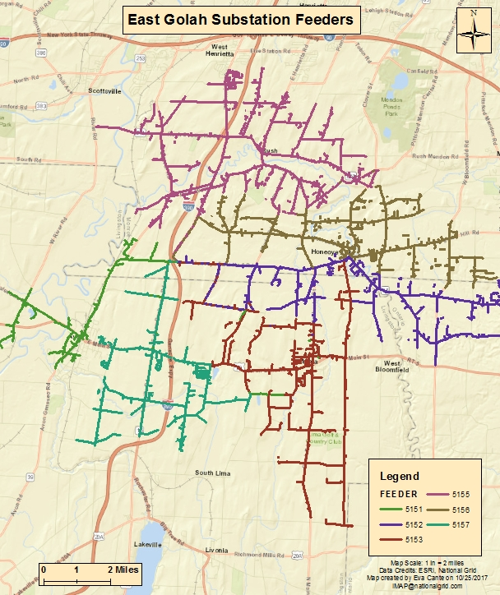
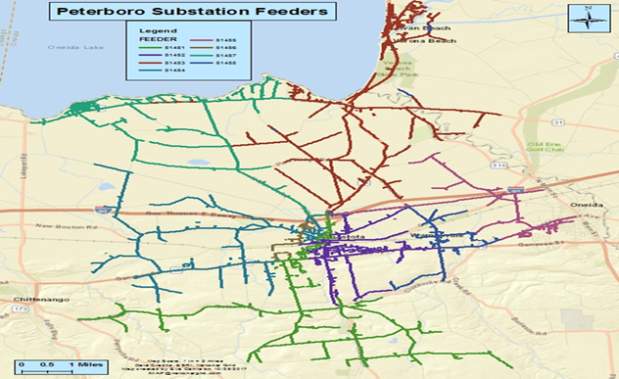
Distributed Generation Interconnection REV Demonstration Project
ALTERNATIVE COST SHARING FOR COMMON SUBSTATION UPGRADES
In 2017, National Grid proposed an alternative cost sharing solutions for increasing the pace and scale of interconnecting DG systems above 50 kW through upfront investments in common upgrades at two substations (Peterboro and East Golah) coupled with a cost-allocation methodology aimed at removing barriers for DG interconnection applicants.
Construction completed in late 2017.
The work included the installation of zero-sequence voltage (“3V₀”) protection and load tap changer (“LTC”) controller upgrades to two transformers at each substation.
This project created 40MW of total hosting capacity.
Both substations queue have sufficient level of DG applications to fully subscribe the 40MW capacity.

Slide 3
Distributed Generation Interconnection REV Demonstration Project
BENEFITS / LESSONS LEARNED
Benefits of programs:
Lessons Learned:
Although successful, the Company’s experience with the initial roll out of the Project, as well as developer feedback, revealed potential opportunities for improvement; namely, the ability to target development in certain areas (e.g., landfills and brownfields), the potential benefits of proactive outreach with communities to educate and address DG project construction concerns (e.g., local moratoria), as well as opportunities for additional technology to reduce construction time and increase hosting capacity.
Reducing upfront cost barriers
Providing increased certainty
Shortening construction timelines

Slide 4
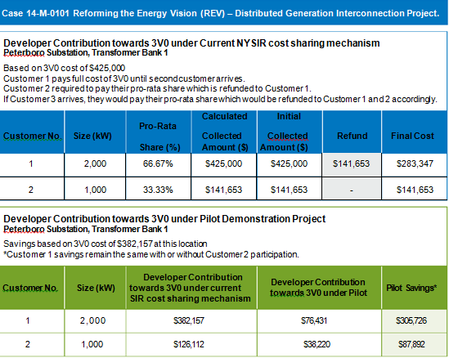
Distributed Generation Interconnection REV Demonstration Project
** The “Common Substation Upgrade Interconnection Fee” ($/kW) is calculated by dividing the sum of the total costs of the substation upgrades by a factor representing the sum of the total hosting capacity in kW.

Slide 5
Distributed Generation Interconnection REV Demonstration Project
SCALING THE COST- ALLOCATION APPROACH
COMMUNITY /MUNICIPAL ENGAGEMENT PROGRAM
National Grid has now proposed to scale the common-upgrade cost-allocation concept by expanding the Project to areas with municipal landfills and brownfield sites that have high DG or DG coupled with energy storage development potential.
These sites have drawn interest from municipal officials and the DG developer community.
Likewise, the NYSERDA has redesigned the NY-Sun MW Block Program to include a new $0.10/kW incentive adder for solar projects on landfill/brownfield sites; further enhancing the economics of developing DG projects in these areas.
Developing DG projects on these sites will benefit municipalities by reducing energy costs, meeting local sustainability commitments, providing an additional stream of revenue via lease payments, and protecting farmland.
The Company has also proposed to test whether proactive outreach to communities and municipalities in these targeted areas can accelerate the pace of DG development by addressing local concerns and reducing permitting delays.

Slide 6
Distributed Generation Interconnection REV Demonstration Project
SCALING THE COST- ALLOCATION APPROACH
COMMUNITY /MUNICIPAL ENGAGEMENT PROGRAM
In collaboration with NYSERDA, the Company has identified twenty-six landfill/brownfield sites located near a section of the Company’s system where substation upgrades have already been installed to accommodate DG projects. National Grid will begin outreach efforts with local communities in those areas to help them develop their landfill/brownfield sites for DG install and will also be marketing the existing capacity to DG developer.
The Company has also identified four substations (71MW capacity increase) where common upgrades are required before DG projects would be capable of interconnecting from nearby landfill sites.
The scope of this Distributed Generation interconnection REV demonstration expansion includes:
Testing whether the cost-allocation approach can be used to facilitate DG development on the following landfills.
Identifying strategies for proactively and constructively engaging communities and municipalities in the DG development process
Substations | Add’l Transformer Bank Capacity | Area Landfill/Brownfield Sites Served | Anticipated Construction
Cedar | 17 MW | Fort Ann, Evans Mills, Moreau and Waterford in Washington, Jefferson and Saratoga counties respectively | March 2020
Indian River | 20 MW
Butler | 17 MW
Prospect Hill | 17 MW

Slide 7
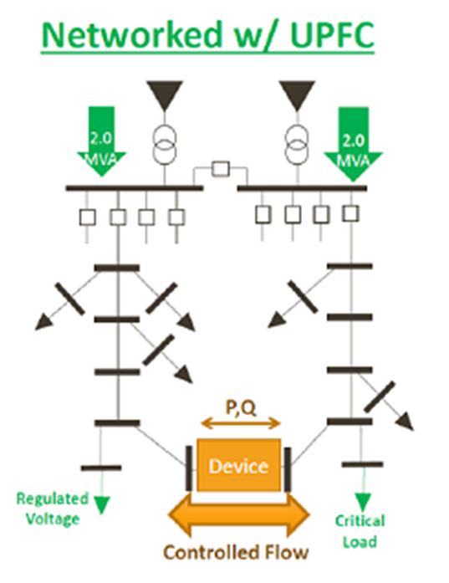
Distributed Generation Interconnection REV Demonstration Project
PILOTING NEW TECHNOLOGIES
Piloting optical voltage transformer (“VT”) equipment replacing coupling capacitor VT (“CCVT”) type in a 115-13.2 kV substation to save construction time on 3V₀ protection installation at substations (20% reduction in overall project construction time).
Piloting switched source technology to potentially help increase hosting capacity through active power flow control, diverting power production to adjacent feeders. Therefore in combination with a 3V0 strategy, the switched source technology will bring additional HC benefits. In addition, the switched source technology provides several other benefits such as load relief, VVO capabilities and reliability improvements that we would like to test as part of this demonstration project.

