Slide 1
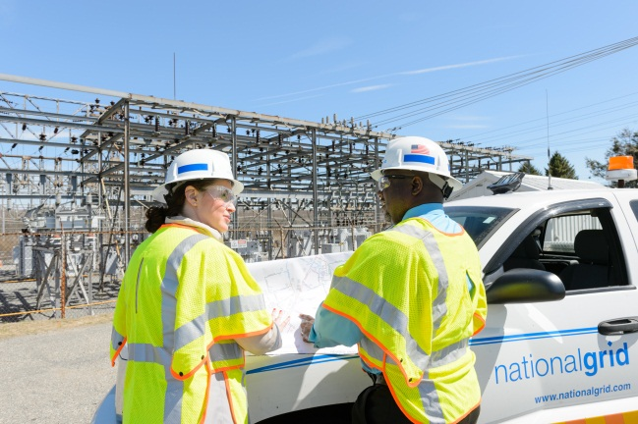
Post-construction Submittals to Utility by Applicant

Slide 2
Post-construction Submittals to Utility by Applicant
To schedule a Field Verification:
PE Stamped and utility-accepted design package
Customer’s PE certified letter that the interconnection facility has been installed according to the mutually accepted design
AHJ inspection certification of the Customer’s premises electrical installation
To schedule a Witness test:
Accepted Field Verification/Engineering audit of Customer interconnection facility
Sequence of Operations (SOO) , Energization Plan (EP) , Testing and Commissioning Plan (TCP)
For Permission to Operate to be issued:
Completed Witness test
Final As-built drawings of the system
As-left settings for relays

Slide 3
Suggested Changes to NYSIR
STEP 10: Interconnection:
The applicant’s facility will be allowed to commence parallel operation upon satisfactory completion of the tests in Step 9 and upon submittal final as-built drawings to the utility. In addition, the applicant must have complied with and must continue to comply with the contractual and technical requirements of the SIR.

Slide 4
Suggested Changes to NYSIR
STEP 11: Final Acceptance and Utility Cost Reconciliation
The applicant shall submit final as-built drawings to the utility after completion of Step 9.
If the utility witnessed the verification testing, then the utility , within ten (10) Business Days of receipt of the facility’s final as-built drawings the completion of such testing, will issue to the applicant either a formal letter of acceptance for interconnection or a detailed explanation of the deficiencies in the system.
If the utility did not witness the verification testing, then, within ten (10) Business Days of receiving the facility’s final as-built drawings written test notification from Step 9 , the utility will either issue to the applicant a formal letter of acceptance for interconnection, or will request that the applicant and utility set a date and time to witness operation of the DG system. This witnessed verification testing must be completed within twenty (20) Business Days after being requested. Within ten (10) Business Days of the completion of any such witnessed testing, the utility will issue to the applicant either a formal letter of acceptance for interconnection or a detailed explanation of the deficiencies in the DG system.
Within sixty (60) Business Days after issuance of the formal letter of acceptance, the utility shall prepare and submit to the applicant a final reconciliation statement of its actual costs, less any minus the application fee and advanced payments made by the applicant. Within twenty (20) Business Days after delivery of the reconciliation statement, the applicant will receive either a bill for any balance due or a reimbursement for overpayment as determined by the utility’s reconciliation. The applicant may contest the reconciliation with the utility. If the utility’s final reconciliation invoice states a balance due from the applicant, unless it is challenged by a formal complaint interposed by the applicant, it shall be paid to the utility within thirty (30) business days or the utility reserves the right to lock the generating system offline. If the utility’s final reconciliation invoice states a reimbursement for overpayment to be paid by the utility, unless the reimbursement amount is challenged by a formal complaint interposed by the applicant, it shall be paid to the applicant within thirty (30) business days. If the applicant is not satisfied, a formal complaint may be filed with the Secretary to the Commission.

