Slide 1
Case 15-E-0751 - Value of Distributed Energy Resources
Order on Net Energy Metering Transition, Phase One of Value of Distributed Energy Resources, and Related Matters
March 24, 2017

Slide 2
Overview of Webinar
Value of DER process
Background and Context
Overview of specific provisions of Commission Order
Phase One Value Stack
Community Distributed Generation Tranche Design
Implementation of VDER Phase One
Cost reduction initiatives and low-income participation
VDER Phase Two
Interaction with other topics and proceedings

Slide 3
Introduction and Housekeeping
The purpose of this webinar is to provide an overview of the Commission’s Phase One decision in the Value of DER proceeding and to also present next steps
The Commission’s Order can be accessed through the following link:
http://on.ny.gov/2n7xYDR
Please submit questions to VDER@dps.ny.gov
Many questions were submitted prior to the webinar
Questions will be addressed as part of the webinar and a FAQ will be posted to the Department’s dedicated forthcoming VDER webpage
All filings in the Value of DER proceeding (Case 15-E-0751) can be accessed through:
http://on.ny.gov/2nBUMyh

Slide 4
VDER Process
Staff directed to develop recommendations and an interim value of DER methodology
Community Distributed Generation Order (15-E-0082) – Dec. 2014
NEM Floating Cap Order (15-E-0407) – July 2015
Value of DER (15-E-0751) commenced by Notice – Dec. 2015
Staff to propose transition plan from NEM to VDER by Dec. 2016
Comments and proposals from parties – April 2016 & June 2016
Both on substance and procedure
Adopted informal and collaborative process – May 2016
10 technical and collaborative conferences led by Staff (open meetings)
Staff had formal and informal dialogue with all active and interested parties
Staff Report and Recommendations – Oct. 2016
35 parties submitted initial comments, 26 reply comments – Dec. 2016
3,000+ public comments submitted to date
Commission VDER Phase One Order – March 2017

Slide 5
Background and Context
Commission directed development of an interim methodology towards more precise DER valuation and compensation
Recognition of the need to avoid policy cliffs but to move beyond NEM
Recognition that the transition will be impacted, in part, by the improvement in technical capabilities (e.g., planning and operational tools) to unlock more precise valuation
Interim methodology (Phase One) should provide for a market transition consistent with the principles of gradualism and predictability. Recognized as first steps
In VDER collaborative with stakeholders, Staff articulated that Phase One should be immediately followed by a Phase Two
The Commission’s VDER Phase One order establishes foundational policies to enable implementation and initial application of the VDER methodology

Slide 6
Background and Context
What does the Phase One order do?
Takes the first step in moving beyond NEM towards more accurate valuation and compensation of DER
Adopts an interim methodology for NEM-eligible DG resources
There is a pressing need to move beyond NEM to better target DG deployment to meet REV objectives and to manage impacts on non-participants
Non-NEM resources remain eligible for various other programs/tariffs, and further investigation is needed before including in VDER to avoid unintended consequences (Phase 2)
Why is the Phase One order necessary?
“In order to incentivize customers and DER providers to install and operate DER in a manner that maximizes the benefits for themselves, the integrated electric system, and society as a whole, compensation must accurately reflect the values created at a granular level.” VDER order, page 20
“By failing to accurately reflect the values provided by and to the DER they compensate, [NEM] will neither encourage the high level of DER development necessary for developing a clean, distributed grid nor incentivize the location, design, and operation of DER in a way that maximizes overall value to all utility customers.” VDER order, page 3

Slide 7
Eligible Technologies for Phase One
Intermittent and non-dispatchable technologies
Solar photovoltaics (PV) generation (less than 2 MW-ac)
Wind generation (less than 2 MW-ac)
Micro-hydroelectric generation (less than 2 MW-ac)
Dispatchable technologies
Farm waste generation (less than 2 MW-ac)
Fuel cell generation (less than 2 MW-ac)
Micro-combined heat and power (CHP) generation (less than 10 kW)
DER technologies not included in Phase One (e.g., DM, DR, EE, non-NEM-eligible DG)
These tech are already eligible for other tariffs and programs
VDER Phase 2 will address inclusion of the broader set of DER technologies

Slide 8
Definition of Project Arrangements
Mass Market
On-site projects, behind the meter of a residential or small commercial customers on a non-demand based rate
Large-scale, on-site
On-site projects, behind the meter of a large commercial customer on a demand based rate or a mandatory hourly pricing (MHP) customer
Remote Net Metering
Off-site projects of non-residential customers or residential customers who own/operate farm operations (hosts); volumetric credits used to offset consumption at multiple host meters
Community Distributed Generation
Off-site projects located behind a non-residential host meter that provides bill credits to members subscribed to the project
In conjunction with VDER order, the Commission approved a waiver of the CDG 10 member minimum requirement for certain projects

Slide 9
Inclusion of Energy Storage
Storage is included in Phase One when paired with an eligible technology
Storage is also permitted under NEM and Phase One NEM
Staff originally proposed that environmental value and market transition credit would be allocated to monthly net export only
As part of implementation, the Commission has directed Staff to consider whether an alternate option, such as commitment to only charge using an eligible VDER resource, can better reflect storage applications and the environmental value they offer
NYSERDA is in the process of developing a solar + storage solicitation
Stand-alone storage and other storage valuation will be taken up in Phase Two

Slide 10
Managing Impacts on Non-participants
To manage impacts on non-participants as a result of net utility revenue impacts associated with Phase One:
Commission adopted an incremental net annual revenue impact of approximately 2% for each utility
Not a hard cap, but used to inform MW allocations for new 1) mass market and 2) CDG projects
Using the 2% as a guide, the Commission established MW allocations based upon 2016 utility peak demand
4% peak demand for O&R and ConEd
7% peak demand for CHG&E, National Grid, NYSEG and RG&E
Incremental MWs detailed in later slides

Slide 11
Tariff Categories Included in Commission Order
Net energy metering (NEM)
VDER Phase One NEM
VDER Phase One Value Stack

Slide 12
A. Net Energy Metering
Projects interconnected or completed construction as of 3/9/2017 will retain NEM compensation methodology
Must have notified utilities of finished projects by 3/17/2017
By 3/31, utilities will submit a filing on all interconnected or constructed systems
Compensation term equals life of the system
Previously grandfathered Remote Net Metering projects
Eligible for monetary crediting for 25-year term if in-service by EOY 2017
Projects continue to be subject to rate design modifications

Slide 13
B. Phase One NEM
Identical to NEM compensation (i.e., volumetric crediting)
Except that projects under Phase One NEM will be subject to a compensation term length of 20-years
After 20 years projects are moved onto the then applicable compensation mechanism
Projects, other than mass market, must be equipped with utility metering capable of recording net hourly consumption and injection
Excess credits eligible for carry-over to subsequent billing and annual periods, with the exception of excess credits held by CDG sponsors (discussed further below)

Slide 14
B. Phase One NEM – mass market
Projects installed after 3/9/2017 but before 1/1/2020 eligible for Phase One NEM
Subject to MW allocation limits specified by Order and guided by Commission decision on 2% net revenue impact
Upon hitting 85% of an allocation, the Commission will determine what action is appropriate

Slide 15
B. Phase One NEM – large projects under development
Opportunity for Phase One NEM during the 90 business-day window from the date of the Order
Eligibility limited to projects that moved forward with development
Have made payment of at least 25% of interconnection upgrade costs, or have executed an interconnection contract if no upgrade payments are required
Non-grandfathered RNM and large-scale, on-site projects are eligible
CDG projects are eligible subject to available capacity in Tranche 0

Slide 16
C. Phase One Value Stack
Applied to projects not eligible for NEM or Phase One NEM
Compensation based on monetary crediting for net-hourly injections
Based on calculations of specific, hourly values of exported generation
Projects compensated by the Value Stack will be subject to a compensation term length of 25-years, after which they are moved onto the then applicable compensation mechanism
The Commission determined that a 25-year term provides appropriate certainty and predictability under this new compensation mechanism
Excess credits eligible for carry-over to subsequent billing and annual periods, with the exception of excess credits held by CDG sponsors (discussed further below)

Slide 17
C. Phase One Value Stack – project eligibility
Community Distributed Generation
With limited opportunity for Phase One NEM
Remote Net Metering
Previously grandfathered RNM projects under monetary crediting are not included
Large onsite projects
Demand metered or mandatory hourly pricing customers
Mass market
One time opt-in onto Value Stack is available

Slide 18
C. Phase One Value Stack – opt-in and metering requirements
Opt-in onto Value Stack
All projects entitled to receive NEM or Phase One NEM are allowed to elect a one-time opt-in onto the Value Stack tariff
CDG and mass market would be placed in the then active CDG tranche
Requires a utility meter capable of reporting net hourly exports
Metering Requirements
Projects must be equipped with a utility meter capable of measuring net hourly import or export to participate in Value Stack
Many larger DG projects are already equipped with the necessary metering
For new RNM & CDG projects, metering must be installed at installation
For large-scale, on-site projects, where an insufficient meter is already present, advanced hourly metering must be installed as soon as practical

Slide 19
C. Phase One Value Stack – market transition credit (MTC)
Initial Estimates of the Value Stack are less than NEM credits would be for Mass Market Customers
Thus, Mass Market Customers that participate in NEM-eligible CDG, or Mass Market Customers with NEM-eligible onsite resources that opt-in to the Value Stack (VS), will also receive an MTC
To avoid market disturbances in the transition away from NEM
To reflect values that are not identified or calculable at this time, especially value of D
Cases where the MTC is not appropriate
Mass market, on-site projects that choose to go on, or remain on, NEM
Large, on-site or RNM commercial projects – Will be better off under Value Stack than under NEM
MTC applied to actual CDG customer composition
Ex. if a project has 70% mass-market off-takers and 30% large commercial off-takers, project gets 70% MTC, and the remaining 30% would receive DRV (i.e., value of D)
The MTC will be calculated by each utility and set one time following the issuance of Commission’s Phase One Order and applies for the full 25 years
MTC = Difference between “Base Retail Rate” and “Estimated Value Stack”

Slide 20
Carryover of Credits under VDER Phase One
Excess credits in a billing period
Carried over to the next billing period as a monetary credit for Value Stack, a volumetric credit for Phase One NEM
No payout of credits at any time
Annual rollover of excess credits
For excess credits that are assigned to a customer/subscriber - rollover of monetary credits until end of compensation term (20 or 25 years)
Any volumetric credits converted to monetary for annual rollover
CDG sponsors have 2 years to allocate any annual excess credits that are not assigned to a subscriber

Slide 21
Renewable Energy Certificates (RECs)
NEM customers without a RPS or RES contract may still receive non-transferrable RECs
Effective immediately, NYSERDA shall relinquish all rights to any environmental claims, certificates, attributes or other embodiments or memorializations of those claims for energy produced by any system to which it provided financial incentives under the CST and NY-Sun programs.
Phase 1 NEM projects will not be eligible for Tier 1 solicitations or tradable RECs
They can receive non-transferrable RECs
For CDG projects, non-transferrable RECs will go to utility by default, but can be ascribed to customer instead
For any VDER project receiving the value stack is ineligible for Tier 1 solicitations, or transferrable RECs, there are two options:
Default Interconnecting-LSE-Option: Utility (LSE) receives non-transferrable RECs, and customers receive environmental value component in value stack (“E”)
Customers may permanently opt into Customer-Retention-Option at time of interconnection. The customers receive non-transferrable RECs but forfeit “E” in the value stack
Customers who register their project in NYGATS and provide generation data will be entitled to receive one REC for each MWh of generation reported
NYGATS can create RECs retroactively to January 1, 2016, but only if the system owner completes the registration process and provides the associated generation data by May 31, 2017.

Slide 22
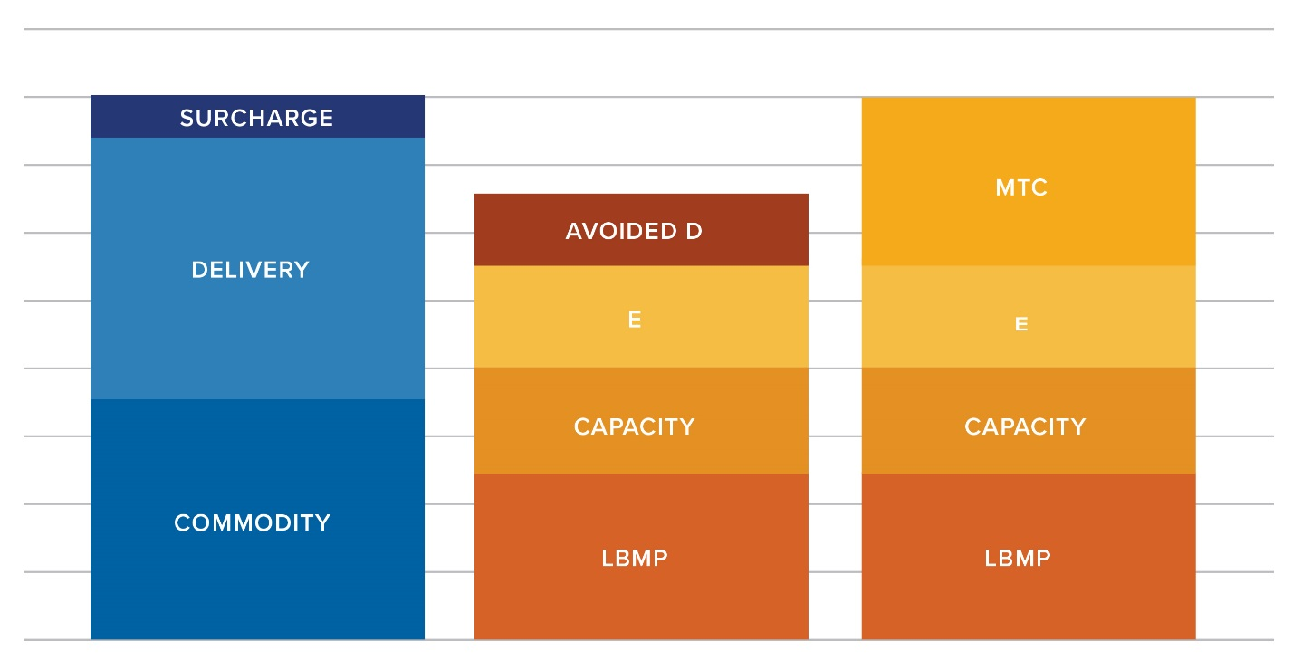
Value Stack Components
Cents/kWh (illustrative)
Avoided D – Includes demand reduction value (DRV) & locational system relief value (LSRV)
E – environmental benefit
Capacity – ICAP
LBMP – energy commodity
MTC – market transition credit for mass market portion of CDG projects, non-mass market portion receives DRV
Base Retail Rate (NEM)
Value Stack + MTC (also eligible for LSRV)
Value Stack

Slide 23
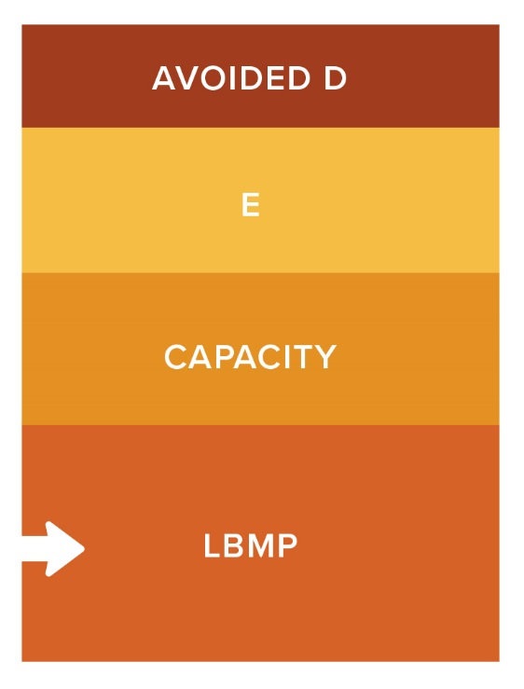
Value Stack Components – energy value (LBMP)
Actual day-ahead NYISO hourly locational based marginal pricing (LBMP) energy price in effect at the time of generation, grossed up for avoided distribution losses

Slide 24
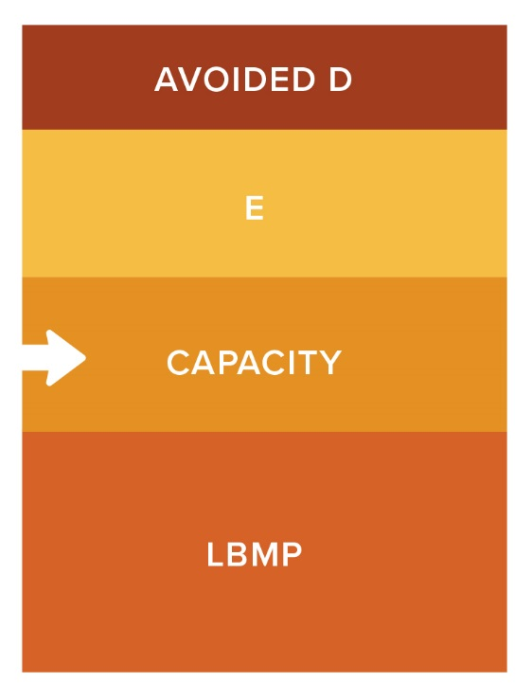
Value Stack Components – installed capacity (ICAP)
PV and other non-dispatchable technologies
Compensation on a per kWh basis, based on the capacity portion of the utility’s full service market supply charges (in effect, same value as NEM)
Option 1 – spread over all hours of the year
Option 2 – spread over 460 summer hours
Dispatchable technologies (ADG, fuel cells, CHP)
Monthly compensation based on NYISO market price for MW performance that was aligned with the peak hour in the prior year, grossed up for avoided reserves and distribution losses

Slide 25
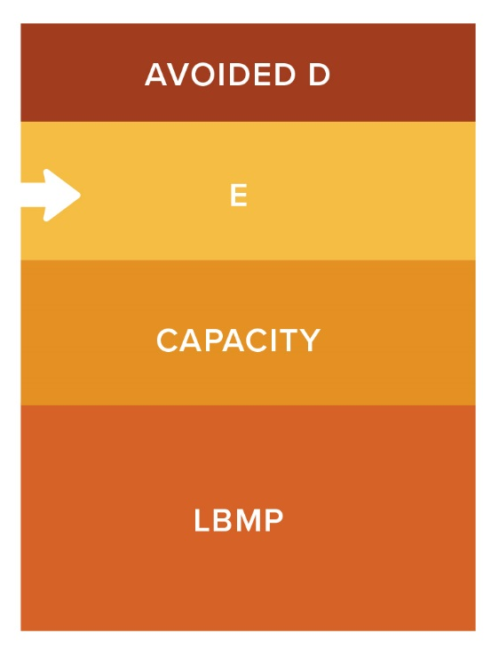
Value Stack Components – environmental value (interconnecting-LSE option)
By default, environmental value for VDER projects is calculated as follows
For technologies (such as PV) that would be eligible for Renewable Energy Standard Tier 1 Renewable Energy Credits (RECs), environmental compensation is the higher of:
the applicable Tier 1 REC price per kWh generated injected (currently $0.02424 per kWh), or
the Social Cost of Carbon (SCC) per kWh value minus RGGI
This value will be fixed for the Value Stack term and is locked in at interconnection
Projects receiving “E” will be ineligible to bid in RES Tier 1 solicitations conducted by NYSERDA, and the interconnecting utility will receive all the Certificates in NYGATS
These Certificates may be Tier 1 eligible but will not be transferrable (i.e., un-tradable, unsellable, non-monetizable)

Slide 26
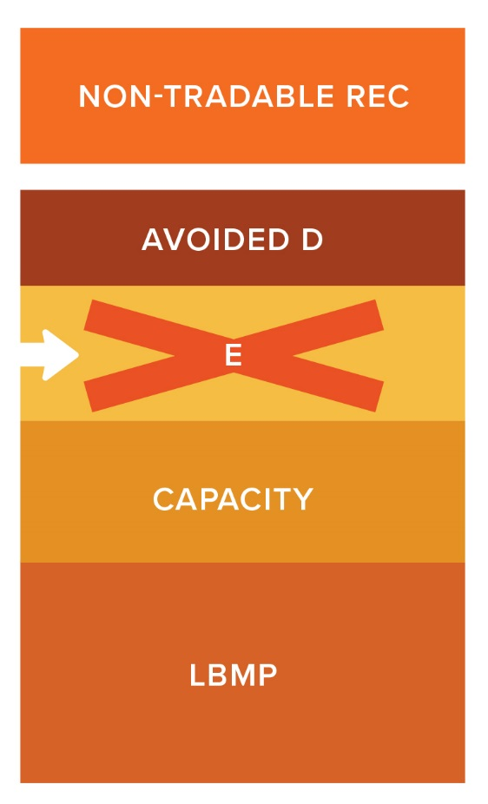
Value Stack Components – environmental value (customer-retention option)
Customers can make a one-time, irreversible decision to opt out of the Interconnection-LSE-Option, and not accept compensation for the Environmental Value component of the Value Stack.
For the Customer-Retention-Option, the customers will be required to return that Environmental Value compensation to the utility in order to gain an opportunity to participate in voluntary market including environmental and sustainability certification programs.
These transactions would be conducted seamlessly by the utility’s billing system and the customer bills need only reflect the net result.
Projects that decline “E” will be ineligible to bid in RES Tier 1 solicitations conducted by NYSERDA and the project owner will receive all the Certificates in NYGATS.
These Certificates will not be Tier 1 eligible and will not be transferrable, but can be retired

Slide 27
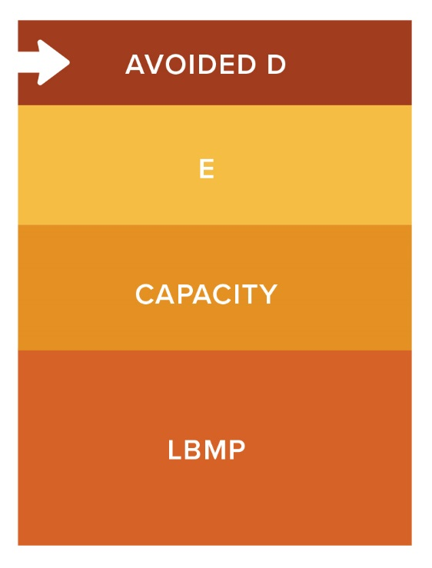
Value Stack Components – value of “D” - demand reduction value
Only for projects that do not receive MTC (projects that are not CDG or Mass Market Opt-in)
For any portion of a CDG project that does not receive the MTC (i.e. large customers), that portion will receive the DRV
Utilities will calculate the $ per kW-year value of demand reduction to the grid
The resulting $ per kW-year value will be distributed across the 10 highest usage hours in a utility’s territory and projects will be compensated based on eligible DG performance during those hours
Utilities will develop an optional portfolio based approach where participating DERs are aggregated into one virtual generation resource with an average nameplate capacity and value and compensate the participants based on that value
Utilities will recalculate DRV every 3 years

Slide 28
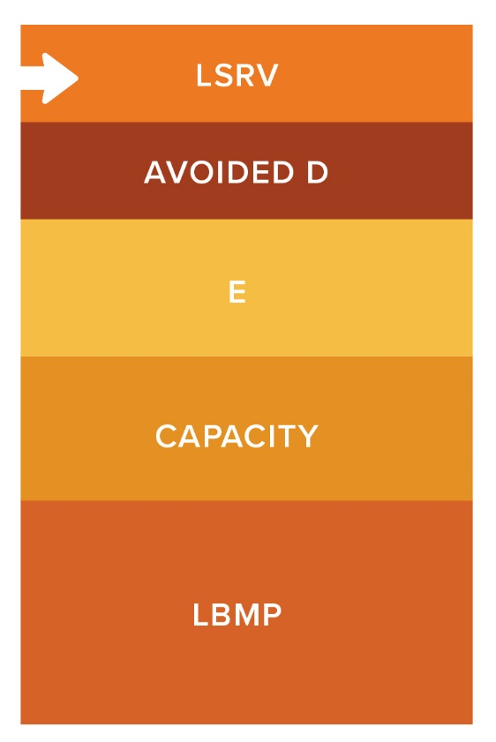
Value Stack Components – value of “D” - locational system relief value
Utilities are required to identify high-value locations and any limits on the MW needed in those areas
LSRV will not apply to all projects
$ per kW-year value identified by utility, locked in and paid for first 10 years of the project
LSRV can be received in addition to MTC, therefore CDG projects are eligible

Slide 29
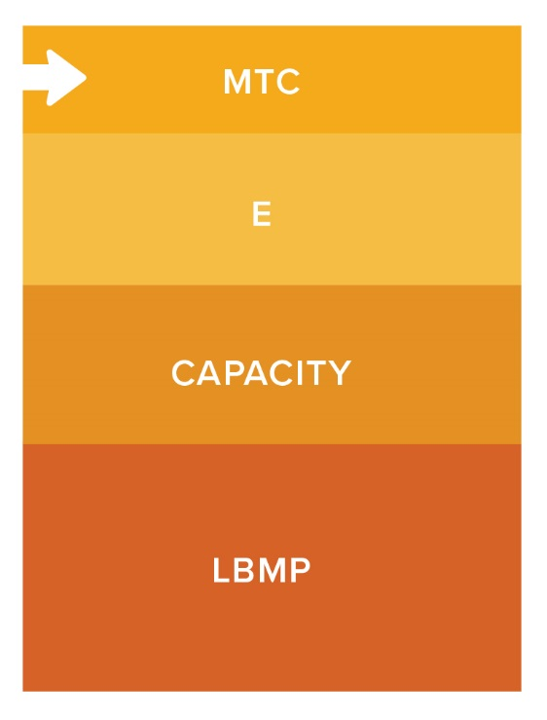
Value Stack Components – market transition credit
CDG projects that are included in Phase One are eligible to receive an MTC for its percentage of mass market customers
for any portion of the project that this not mass market, that portion is eligible for the DRV
receipt of MTC does not preclude project from receiving LSRV
Intended to make estimated CDG compensation
equal to “Base Retail Rates” (NEM) in Tranche 1
5% less than NEM in Tranche 2, and
10% less than NEM in Tranche 3

Slide 30
CDG Tranche Design
Phase 1 NEM projects (Tranche 0) receive 20-year NEM
Open for 90 business days after the order, or until capacity full
Any remaining capacity moves into Tranche 1
Tranche 1: 25-year, NEM equivalent, incorporates value stack
Tranche 2: 25-year, 95% NEM equivalent, incorporates value stack
Tranche 3: 25-year, 90% NEM equivalent, incorporates value stack
Phase 1 NEM and Tranche 0 are volumetric crediting methods, Tranches 1-3 use monetary crediting
Project criteria to enter tranche is 25% utility interconnection upgrade payment or an executed utility interconnection agreement if upgrade costs are not applicable
MTC steps down in Tranches 2 and 3

Slide 31
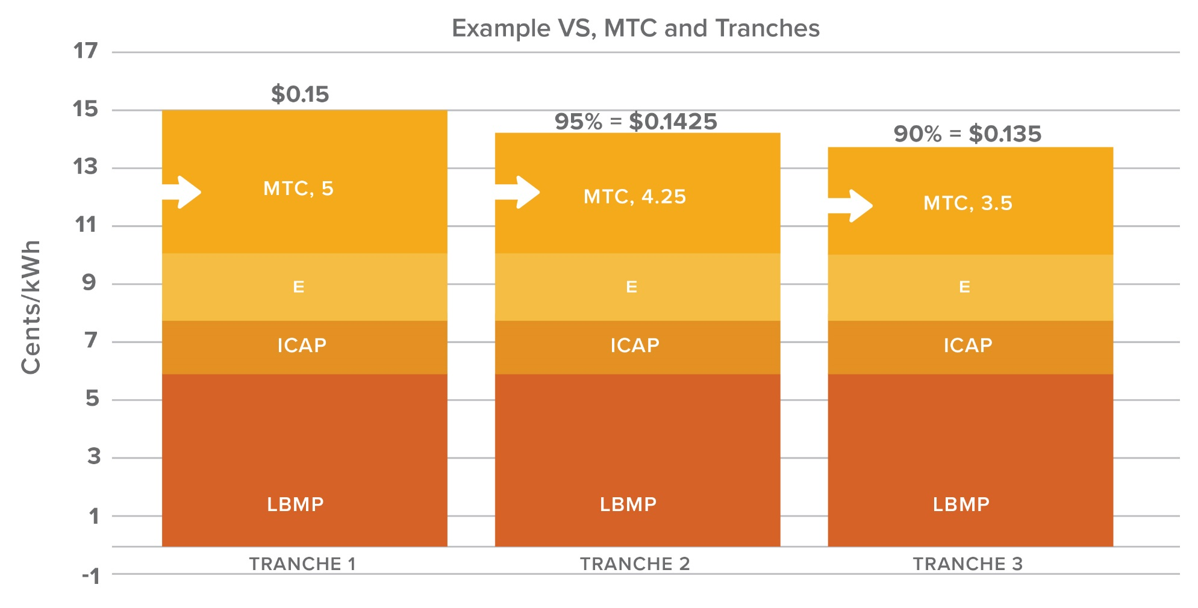
CDG Tranche Design
Note – Illustrations do not reflect DRV compensation eligible for non-mass market subscribers or the potential for the project to receive LSRV compensation

Slide 32
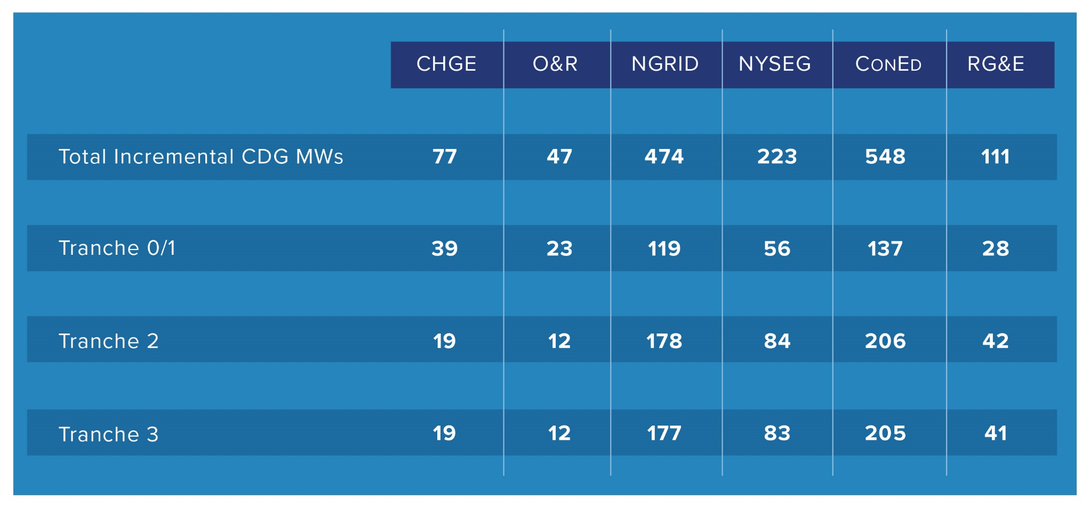
CDG Tranche Design – MW allocation by utility
VDER, Assumptions

Slide 33
CDG Tranche Design
How many projects are currently eligible?
The utilities were directed to file the number of eligible projects (next slide)
The utilities are also directed to provide real-time updates on tranche progress
Staff is working directly with utilities to develop an approach
And to provide notice when a tranche is full
Upon reaching 85% of total MW allocation for all tranches
A utility should provide notice to the Commission
And the Commission will take up consideration of any appropriate action
Until the Commission takes action, eligible projects will be placed into Tranche 3
VDER, Assumptions

Slide 34
CDG Tranche Design – MWs currently eligible (as of 3/23/17)
Tranche Closed
VDER, Assumptions
MWs currently eligible
26
23
< 1
56
< 2
14
MWs currently eligible
12
48
MWs currently eligible
1
**This chart will be posted and regularly updated on the DPS website

Slide 35
Implementation of VDER Phase One
Technical Conference – April 5th and 6th
Utility Implementation Proposals – May 1st
Potential Staff Report regarding cost reduction initiatives
Public comment period on the above filings
Commission consideration as early as August

Slide 36
Implementation of VDER Phase One – value of “D”
Utilities are at the beginning stages of identifying and calculating all potential distributed system values
While some data is available to determine today, we need much more
Next steps on value of “D”
Most recent MCOS studies and workpapers within 10 days of Order – done
Followed by filing of specific DRV and LSRV values by May 1st, including specific locations and MW caps for LSRV
Within 45 days, utilities shall file an explicit workplan and timeline for developing locationally granular prices to reflect full value to their system from DER
Development of an optional utility fee-based portfolio service under which participating DERs are aggregated into a virtual generation resource in order to help mitigate risk

Slide 37
Implementation of VDER Phase One – tech conference
April 5th and 6th in Albany
Preliminary agenda (seeking comment): http://on.ny.gov/2mVop9f
Utility presentations following by Q&A on the following Phase One aspects (DAY 1)
DRV and LSRV
Cost recovery and allocation
Capacity value
Market Transition Credit and application
Metering
Staff facilitated consultations and discussions on the following aspects (DAY 2)
Development costs (e.g., project size, financing, NY-Sun, use of utility property)
Consolidated billing
Customer maintenance costs
Interconnection
Enabling low-income participation

Slide 38
Implementation of VDER Phase One – utility implementation proposals
Calculation/compensation methodology for DRV
Identification of, and compensation for LSRV along with MW caps and locations
Methods and values for installed capacity approach, two approaches
Identification of an average generation profile for capacity and DRV compensation for a projects’ first year of operation
Cost allocation and recovery methods for each of the components of the value stack (energy, capacity, environmental, DRV, LSR) and the MTC
Proposed accounting transactions and ratemaking treatment
Utility billing management process for allocating bill credits
Draft tariffs for Value Stack including application of value components along with MTC calculations

Slide 39
Implementation of VDER Phase One – near term utility obligations
Report on CDG projects that have paid 25% of interconnection costs – March 16th
File most recent marginal costs of service studies – March 23rd
Report final MW capacity of interconnected/grandfathered under NEM – March 31st
Utilities to expeditiously file leaves for Phase One NEM – effective April 1st
File an explicit workplan and timeline for developing locationally granular prices to reflect full value to their system from DER – within 45 days of Order
Develop a method for providing real-time updates on the capacity left in each CDG Tranche, and file regular letters stating the current amount of capacity remaining in each tranche; immediately file letters stating that a tranche has been filled
** Above information can be accessed through the VDER docket (Case 15-E-0751), http://on.ny.gov/2nBUMyh

Slide 40
Cost Reduction Initiatives
Project size
Allowing projects larger than 2 MW-ac in size to participate in the VDER program could significantly lower per-MW costs
Interconnection costs
Cost sharing – Previously adopted by Commission, additional steps to comes
Cost containment – NYSERDA and Staff track interconnection costs and provide recommendations to Commission to address transparency and alignment of costs with industry standards
NYSERDA education and outreach
Ramp up municipal education to bring efficiencies to permitting/zoning
Ramp up municipal education regarding property tax exemption and PILOT calculations
CDG customer maintenance and operations
Explore communications options to bring efficiency to CDG customer management
Explore on-bill mechanisms and utility services for CDG customer transactions
Financing Costs
Credit support through the Green Bank
Options for NY-Sun redesign

Slide 41
Low Income Participation
Inter-zonal CDG Credit Program
Staff to work with utilities and stakeholders to develop such a program to provide benefits from CDG projects interconnected in other service territories than that of the low-income customer
NYSERDA LMI solar programs
NYSERDA is developing a LMI solar program to focus on CDG participation
Continue to explore Green Bank opportunities regarding credit & financing issues and opportunities
Consider options for Phase One to encourage and incent low-income participation
Consideration of design options for CDG projects that comprise a majority of low-income off-takers
Staff low-income proposal due September 1, 2017

Slide 42
Value of DER Phase Two
Scheduling conference will be held in May 2017
Establish framework for the consideration of rate design and development of network access charges
Improvements and modifications to the value stack, including components related to the bulk system, distribution system and societal values
Application of VDER to projects and technologies not eligible for Phase One (e.g., NEM projects larger than 2 MW, CHP larger than 10 kW, non-NEM eligible technologies, non-generation DERs, stand-alone energy storage technologies)
Transitioning of mass market projects beginning January 2020
Per Commission Order – action on recommendations developed during Phase Two need not wait until the complete consideration of all topics

Slide 43
Interaction with other Topics and Proceedings
DSIPs
Utility DSIPs will serve as the venue for pursuing increased DSP functionality
Increased DSP functionality and capabilities are key for granular pricing of DER
DER Oversight & Consumer Protection
Staff whitepaper filed within 30 days of Phase One Order for public comment
Commission consideration of provisions in conjunction with Phase One implementation
Benefit-Cost Analysis Handbooks
Staff plan to engage with stakeholder over the coming year to work through aspects of the BCA handbooks
Low-income CDG collaborative and Clean Energy Fund
Staff low-income proposal to be filed by September 1, 2017
NYSERDA to consider options via CEF

Slide 44
Wrap Up
A recording of this webinar along with these slides will be available on the Department’s website
http://www3.dps.ny.gov/W/PSCWeb.nsf/SN/Webcasts
Any additional questions can be sent to:
VDER@dps.ny.gov
Thank you for your attention!

