Slide 1
VDER & the NYC Solar Market:
Design & Implementation Recommendations
for Future Growth & Stability
VDER Value Stack Working Group
NYS Department of Public Service
March 6, 2018

Slide 2
NYC Solar Business Alliance
Notes:
Who we are. “NYC SBA represents a diverse coalition of solar industry installers and service providers serving the commercial, industrial, residential and community solar markets throughout the five boroughs and greater NYC metro area.”

Slide 3
VDER, Solar & the NYC Context
Historical NEM related barriers to solar adoption in NYC
VDER has the potential to overcome these barriers
Design revisions are necessary to sustain & expand solar adoption in NYC in line with NYS’s climate, environmental & grid modernization goals

Slide 4
Main Principles Behind Recommendations
Maintain project bankability, reduce complexity
Give all New York ratepayers the opportunity to participate in CDG
Incorporate full social and environmental benefits of CDG in VDER
Increase transparency & accountability in determination/estimation of VDER rates
Notes:
Bullets in bold are what we are going to discuss in detail in this presentation. Others are only previewed and NYCSBA will advance recommendation through participation in appropriate working groups

Slide 5
Main Principles Behind Recommendations
Maintain project bankability, reduce complexity
Give all New York ratepayers the opportunity to participate in CDG
Incorporate full social and environmental benefits of CDG in VDER
Increase transparency & accountability in determination/estimation of VDER rates
Notes:
Starting with bakability/complexity . . .

Slide 6
Simplify DRV & Make It Bankable During Phase 1
Recommendation 1. Set the Con Ed DRV Rate according to the utility territory peak, not the CSRP Zones
Recommendation 2. Introduce DVR Floor Rate
Recommendation 3. Extend DRV period from 3 to 10 years
Notes:
Three recommendations under the banner of simplification and bankability

Slide 7
ConEd DRV Overly Complex for Phase 1
Significantly more complex than other utilities
76 CSRP Zones within one Load Zone
Market cannot understand it
Customers
Developers
Financiers
Phase 1 Transitional Period should be simple & consistent
Notes:
Next three slides provide context and justification for recommendations 1-3

Slide 8
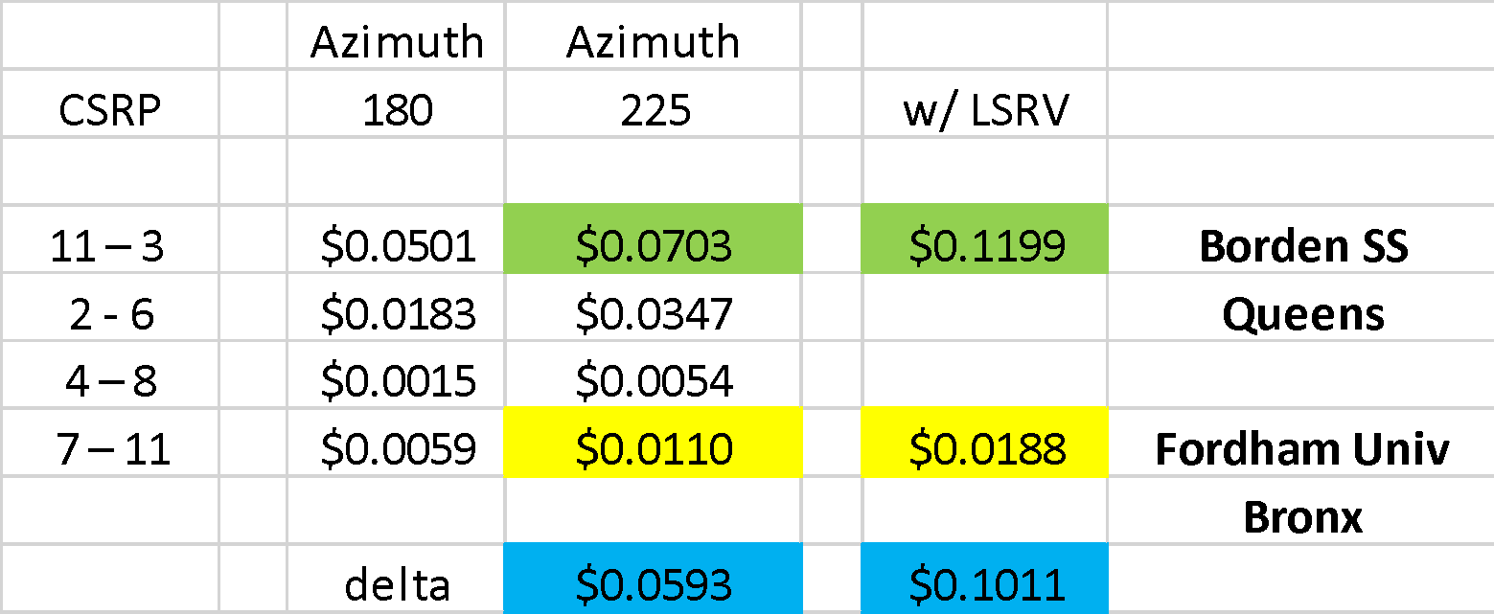
Same Systems – Two LSRV Zones
Fordham University estimated to receive approx. $0.10/kWh less than the same system in Queens ($0.06/kWh DRV & $0.04/kWh LSRV)
Fordham combined VDER rate $0.1084/kWh vs $0.2185 Borden

Slide 9
DVR Component Rate “Unbankable”
Fixed for 3 years from customer-generator’s in-service date, then
Reset & fixed for 3 more years at the end of initial three year period, based on the then applicable DRV rate as shown on the Value Stack Credits Statement.

Slide 10
Rec #1 - Set Con Ed DRV Rate According to Utility Territory Peak, Not CSRP Zones
Insufficient justification to support that the D value of DG is truly limited to a particular CSRP zone
Would increase compensation for large on-site, RNM & commercial (demand-billed) CDG off-takers in most outer boroughs (where solar potential is highest)

Slide 11
Rec #2 - Create DVR Rate Floor
NEM compensation was simple, tied compensation to customer rate - VDER makes rate dependent on factors most customers have no idea how to estimate or predict
D value can be a significant percent of Value Stack in Con Edison
Without a minimum guaranteed value for D component, solar PV projects will not be financeable

Slide 12
Rec #3 - Extend DRV period from 3 to 10 years
Modifying the DRV value every three years introduces too much uncertainty & renders projects unfinanceable
DRV modification every 3 years (for existing projects eliminates “first-mover” incentives for DG developers

Slide 13
Main Principles Behind Recommendations
Maintain project bankability, reduce complexity
Give all New York ratepayers the opportunity to participate in CDG
Incorporate full social and environmental benefits of CDG in VDER
Increase transparency & accountability in determination /estimation of VDER rates
Notes:
Moving on to equity recommendations (MM-MS)

Slide 14
Rec #4 - Extend MTC to Benefit Residents of MM & M/SM Buildings
Extend the MTC or create another mechanism for customers in MM & M/SM buildings to participate in CDG.
2.5 MM or 30% NYC population & 13% of NYS population* are in MM/ M/SM buildings
Comprise a high percentage of NYC LMI customers - environmental justice concern
MM & M/SM contribute equally to System Benefit Charge & Clean Energy programs, though indirectly
*Source: US Census American Community Survey, Population, Housing Units
Notes:
US Census 2016 Projection Quick Facts https://www.census.gov/quickfacts/fact/table/newyorkcitynewyork#viewtop
Population 2016 projected
NYC -- 8.5 MM on
NYS -- 19.8 MM
Housing Units 2016 (US Census-ACS) 3.4 million units with 2.5 persons on average per unit
Apts
P/Bldg People % NYC %NYS
10+ 4.4 MM 51% 22%
20+ 3.9 MM 46% 20%
50+ 2.5 MM 30+ 13%

Slide 15
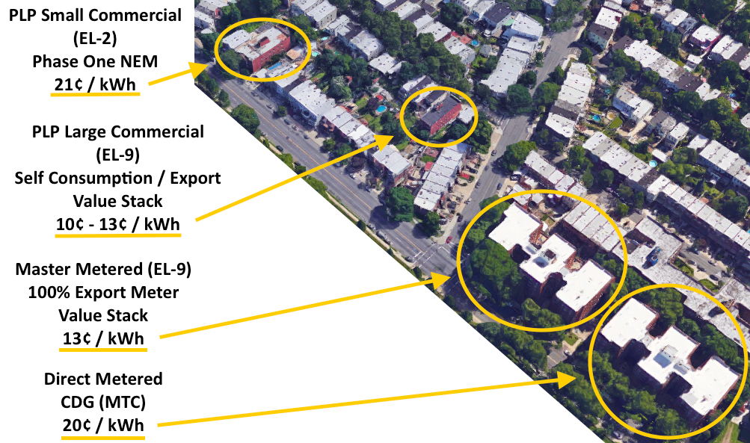
Current VDER Tariff Not Equitable Among Residential Customers
Notes:
The ¢/kWh #’'s are the value of solar at these various residential buildings:
#1 EL2 NEM = 21¢/kWh
#2 Self consumption = 10¢/kWh
Export VDER = 13¢/kWh
#3 100% Solar Export Meter VDER = 13¢/kWh credited to Master Meter via RNM
#4 Direct Metered Multifamily onsite CDG = 20¢/kWh
These are not geographically scattered buildings justifying various solar values as per VDER design principles. And they are all residential. NEM or MTC for all residential would level the solar valuation and simplify a very complex value proposition
Some PLP accounts are just under 10kW Max Demand. If they increase Load (e.g. heat pumps), they could be switched from an EL2 to an EL9 rate classification and their Solar value drop considerably.
Choice of either MTC or NEM (Phase One for on site mass market) would mitigate risk.

Slide 16
Additional Recommendations of NYC SBA
Expand E layer to include:
local air pollutants
health impacts
Other Economic impacts
Shift current ‘calculator’ to online, transparent, user-friendly platform:
No trust in downloaded spreadsheet that can be modified by different vendors
NYSERDA or PSC branded
Locate on .ny.gov website
Documentation
Notes:
30 second overview of other items that will NYC SBA will be advocating for in future WG proceedings in 2018

Slide 17
Thank you

Slide 18
Thank You
Mike Brusic Chris Neidl
mbrusic@brightpower.com neidl@brooklynsolarworks.com
Dennis Phayre Mike Weiss
dphayre@entersolar.com weiss@solar1.org
Janet Handal
janet@handal.com
l

