Slide 1
Power line carrier permissive islanding detection: a NYSERDA-supported project
Michael Ropp, Ph.D., P.E.
Northern Plains Power Technologies

Slide 2
The concept
For many years, NPPT has been experimenting with subharmonic, or undertone, based power line carrier permissive (PLCP), for islanding detection.
Low-frequency signals do not suffer form the propagation and cross-coupling issues that plague high-frequency systems. However, injecting the low-frequency signal is problematic.
This project involves the use of a dynamic voltage restorer (DVR) to inject the subharmonic at the substation level.
Objectives of the project: prove technical feasibility, and get a first-order estimate of costs.

Slide 3
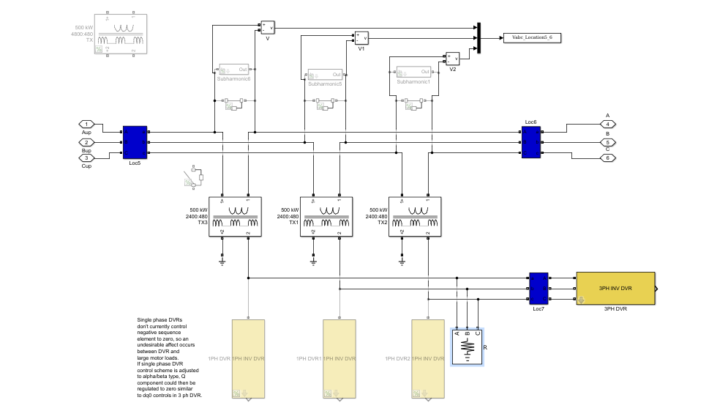
The “transmitter”
Fault protection switches
Series injection transformers
Inverter (implemented as three separate single-phase bridges)

Slide 4
Results to date
Studies being conducted on three real-world NY circuits: one strong, one weak, one average. Two contain a great deal of UG, and one includes a synchronous generator.
Fictitious DERs are added to the circuit, with signal receivers.
Tests include:
Signal propagation
Islanding detection effectiveness
Ability to detect single-phase open circuits
Work will conclude with a first-order cost estimate

Slide 5
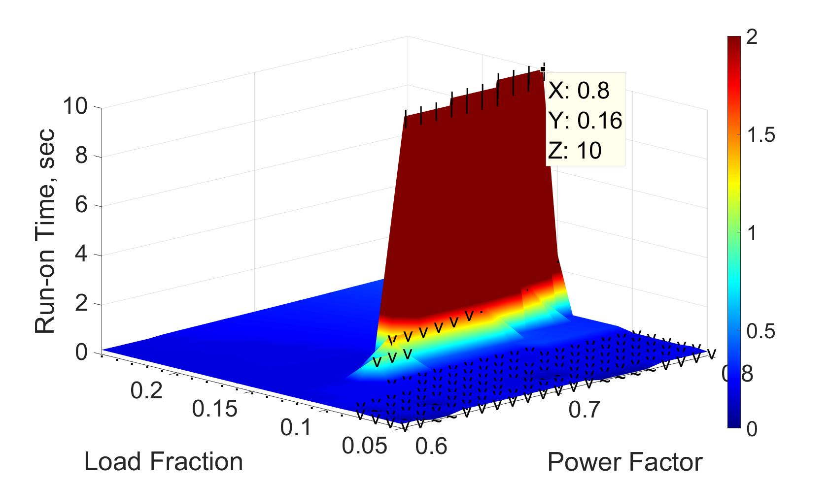
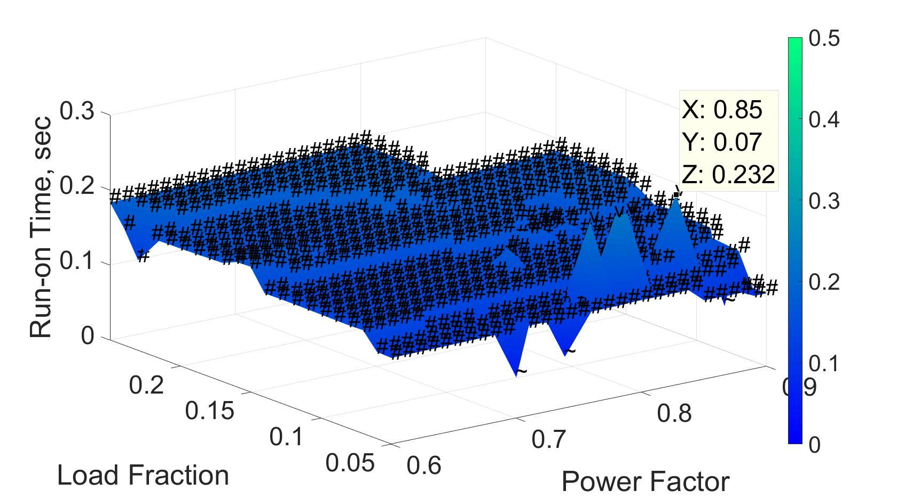
Example islanding detection result
Run-on times without PLCP and without any active anti-islanding.
Run-on times with PLCP but still without any active anti-islanding.

Slide 6
Single phase open circuit detection results
 |  | YG:yg |  |  | YG:d |  |  | D:yg
Feeder | Location | A | B | C | A | B | C | A | B | C
1 | PV (LV) | 100% | 94% | 59% | 89% | 100% | 80% | 84% | 101% | 68%
 | PV (MV) | 99% | 94% | 59% | 99% | 93% | 76% | 99% | 94% | 58%
2 | PV (LV) | 112% | 95% | 32% | 87% | 102% | 77% | 100% | 102% | 5%
 | PV (MV) | 101% | 99% | 25% | 100% | 98% | 63% | 100% | 99% | 76%
3 | PV (LV) | 102% | 99% | 21% | 97% | 100% | 95% | 92% | 100% | 11%
 | PV (MV) | 100% | 100% | 20% | 100% | 99% | 92% | 100% | 100% | 91%
Mixed results; didn’t always work. Still investigating.

