Slide 1
Community Solar, Remote Net Metering, and Behind the Meter Solar Update
Solar Progress Partnership*
Summary of April 18, 2016 Comments
The Solar Progress Partnership consists of Central Hudson, Con Edison, NYSEG, National Grid O&R, SolarCity, Sun Edison, SunPower and RG&E and was facilitated by the Advanced Energy Economy Institute.

Slide 2
Background / Introduction
Responsive to December 23, 2015 Notice and discussion at January 7, 2016 preliminary conference:
Meets the goal of developing a proposal for an interim successor to existing NEM tariffs
Builds on Staff’s BCA White Paper and subsequent Commission Order
Meets request of ALJ for parties to collaborate and seek out common ground
Offered as input to ongoing process in this proceeding

Slide 3
Summary of Comments
Create a stable compensation mechanism for solar resources that aligns with the value those resources provide
Create a transition from full retail NEM to LMP+D+E for all customers
Provide a mechanism to bound and better allocate revenue requirement impacts of NEM projects, while maintaining certainty and simplicity of rules for participants
Assist with management of interconnection queue
Notes:
Lisa Frantzis

Slide 4
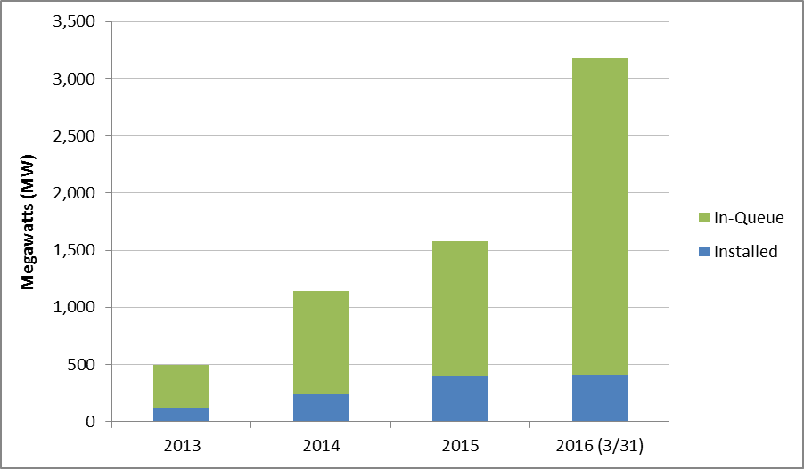
Growth of Net Energy Metering in New York
Net Metered Resources Installed and In Queue, Statewide

Slide 5
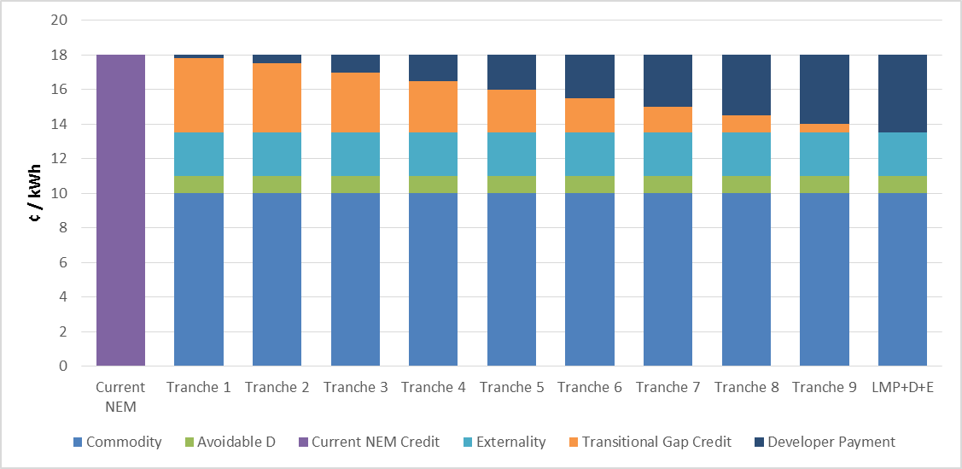
Community Solar Compensation with Developer Payments
Project valued at LMP (wholesale) + D (avoided system costs) + E (externality value) + transitional gap credit
D and E values to be determined based on BCA Order and can evolve over time but will be fixed for each project / tranche
Commission to set size of MW tranches (and revenue shift impact) based on “acceptable” impact and public policy considerations
Step down process utilizing ~ 10 tranches to move to LMP+D+E
Time frame and number of tranches set to accommodate Commission determination
Customers receive full bill credit
Notes: Figures are for illustrative purposes only
“Externality” based on either the Societal Cost of Carbon or a REC value
Potential “Avoidable D” value based on ability to relieve system constraints with non-wires alternatives
Transitional Gap Credit includes RPS and SBC charges

Slide 6
Community Solar Compensation with Developer Payments
Customers would receive a bill credit equal to the full retail rate
Developer would pay utility a fee based on each project’s actual MWh of generation, respective tranche and the assigned transitional gap credit
Compensation for first tranche initially set just below the retail rate
Developer fee would increase with increases in customer delivery rate
Shift in revenue requirement associated with “value of D and E” and transitional gap credit reallocated to all customers in a surcharge mechanism
Utilities can request letter of credit or other financial security to address risk of non-payment

Slide 7
Community Solar Compensation with Developer Payments
Illustrative cash flow
Community Solar
Customer
Solar PPA
Customer’s Retail Rate e.g. $.18/kWh credit
Solar
Utility
Initial Developer Payment
e.g. $.02/kWh
Community Solar Production
(kWh)

Slide 8
Open Issues on Community Solar Compensation
Size of MW tranches (and revenue shift impact) determined by Commission based on “acceptable” impact and public policy considerations
Disagreement over whether a similar step-down process should be applied to Remote Net Metering projects with monetary credits
Duration of “grandfathered” compensation
Expressed as a range of 15-25 years including both period of initial compensation and transition to LMP+D+E

Slide 9
Queue Management
Objectives:
Efficiently work through queue of projects
Provide timely and accurate cost/value information to developers to allow informed judgments on whether to proceed
Prioritization of queue based on:
1) locational distribution system value (as determined by utility)
2) date stamp of interconnection request
Utilities to communicate to each developer what tranche they are in and what interconnection cost is at preliminary / supplemental review
Developer has finite time to agree/accept
To extent projects don’t proceed, utilities will reallocate “area under the curve” of unused tranches
Other issues referred to Interconnection Technical Working Group including
Potential grouping of projects for assignment of common costs

Slide 10
Behind The Meter (BTM) Solar Proposal
New BTM projects eligible for full retail NEM through January 1, 2020 unless PSC initiates a circuit breaker
Circuit breaker if pace of installations results in bill impacts that merit action
Beginning in 2020, new BTM projects eligible for defined but declining compensation based on either (1) defined annual timeframes or (2) volume (MW) of new BTM applications
Transition to an LMP+D+E rate for net exports (customers can also opt-in directly to this rate)
Compensation defined for 15-25 years including both period of initial compensation and transition to LMP+D+E
BTM generation which does not result in net energy exports treated like load reduction
Agreement to work on customer education and engagement and importance of a Smart Home rate or program

