Slide 1
Interconnection Policy Working Group
September, 17th 2018

Slide 2
Agenda
Con Edison’s Distribution System Overview
NY SIR Preliminary Screening Analysis
Technical Screen A
Proposed Technical Screen A1
Other considerations

Slide 3
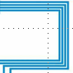
Electric Operations Overview Distribution
4kV, 13kV,
27kV, or 33kV
The distribution system supplies power to low voltage Network customers and Radial customers from area substations at the primary service voltage levels.
Majority of customers receive low voltage service directly at the distribution system secondary voltage levels
A small percentage of high voltage customers receive power at primary service voltage
Area Substation
Transformers
Feeders
480, 208, or 120 V
Radial System
Supplies 13% of System Demand
64 Network Systems
Supply 87% of System Demand

Slide 4
Typical Network Grid
Network Transformer
Network Protector
Area Substation
Substation Breakers
A
PV Customer
B
Standard Customer
C
120/208 Volt
Secondary Network Grid
D
E
Primary Feeder
(13/27/33 kV)

Slide 5
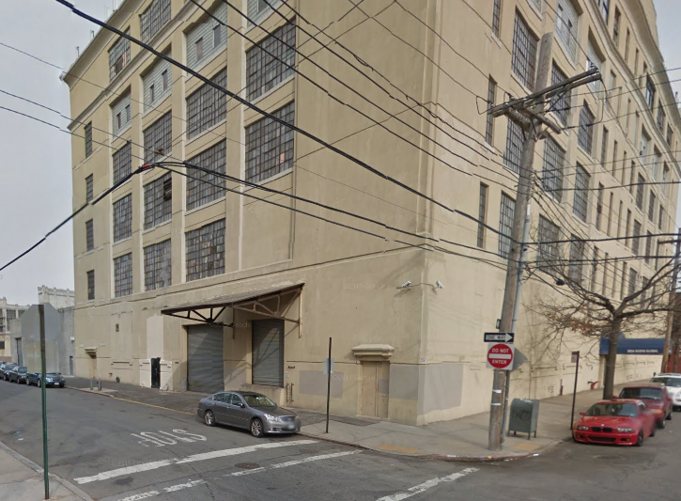
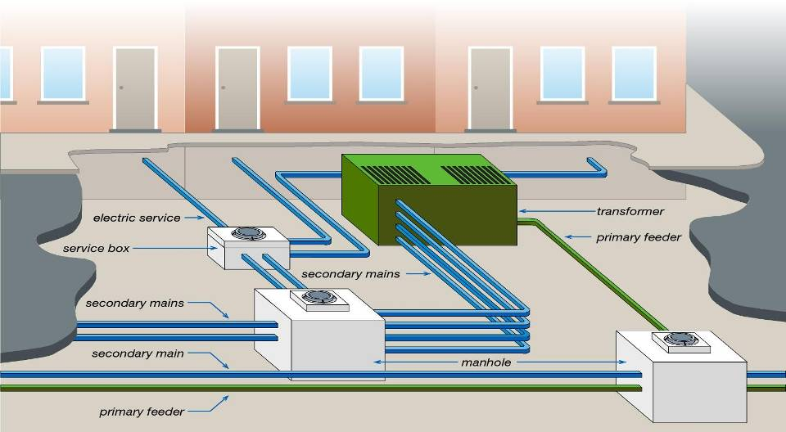
DG Implications: Network Grid Service
Export capability dependent upon multiple factors
PV size vs service capacity
Network loading
Nearby transformer loading
Upgrades to service may require street work
Localized underground
Increased customer cost & timeline

Slide 6
Spot or Isolated Network
Network Transformer
Network Protector
Area Substation
Substation Breakers
A
PV Customer
B
Standard Customer
C
D
E
120/208 Volt
Network Grid
Large Customer
Primary Feeder
(13/27/33 kV)
Spot or Isolated
Network

Slide 7
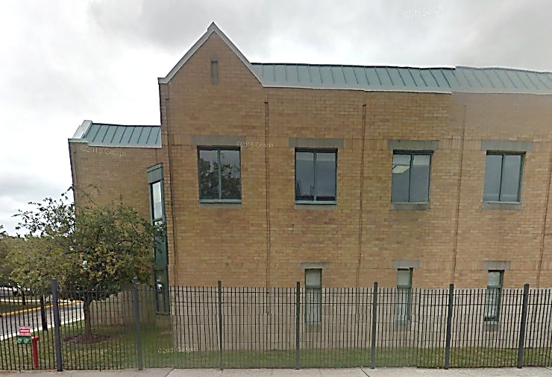
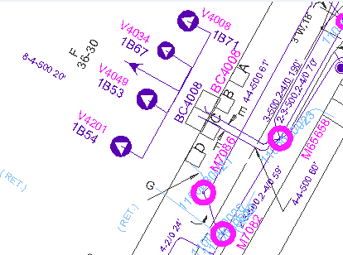
DG Implications: Isolated/Spot Network
Opening of network protector(s) would result in power loss to customer
Cannot accept export without upgrades
Solutions to enable export across network protector relays
Additional interconnection costs to accept export

Slide 8
DG Export Solutions for Network System
Anti-Pumping Protection (APP):
Application: Network grid service
Description: Modifications to nearby transformers’ relays
Typical Cost: Up to $50K
Communications Aided Tripping (CAT):
Application: Isolated/Spot Network
Description: Modifications to impacted transformers’ relays and communication to customer inverters.
Typical Cost: $70-100K

Slide 9
NY SIR Preliminary Screening Analysis
The utility performs Preliminary Screening Analysis for applications above 50kW to 5MW
Appendix G details technical screens A through F
If proposed DG system passes all of the technical screens the utility provides the applicant permission to build

Slide 10
Preliminary Screen A
Screen A: Is the PCC on a Networked Secondary System?
Does the proposed system connect to a secondary network system?
Technical Screen A fails all applicants if the “Proposed system is connected to a secondary network system”. This results in either supplemental screen or CESIR study if the project would like to proceed to construction phase
Con Edison has an extensive secondary network system resulting in many applications failing Screen A
Con Edison is proposing additional Screen A1 only for Con Edison’s service territory

Slide 11
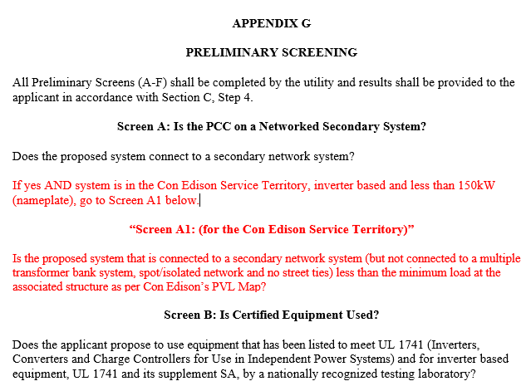
Preliminary Screen A 1

Slide 12
2017 Projects Breakdown
98% of DG installations in CE territory are PV, 1% are CHP
65% PV projects entering in the queue in 2017 were below 150kW
81 cases that went through a CESIR study
in 2017 indicated that:
Out of the 81, only 64 were eligible for Screen A1 as 17 were overhead or new service.
Out of the 64 eligible for Screen A1
60% would have failed Screen A1
40% would have passed Screen A1

Slide 13
Internal Process to conduct Screen A 1
Example:
Address: 141 East 48th St, New York, NY
Structure Name: M9359
M&S Plate: 28-J
Proposed 100 kW PV System
Step 1: Find the associated structure that the PV system wants to connect to using our Internal Vision Maps

Slide 14
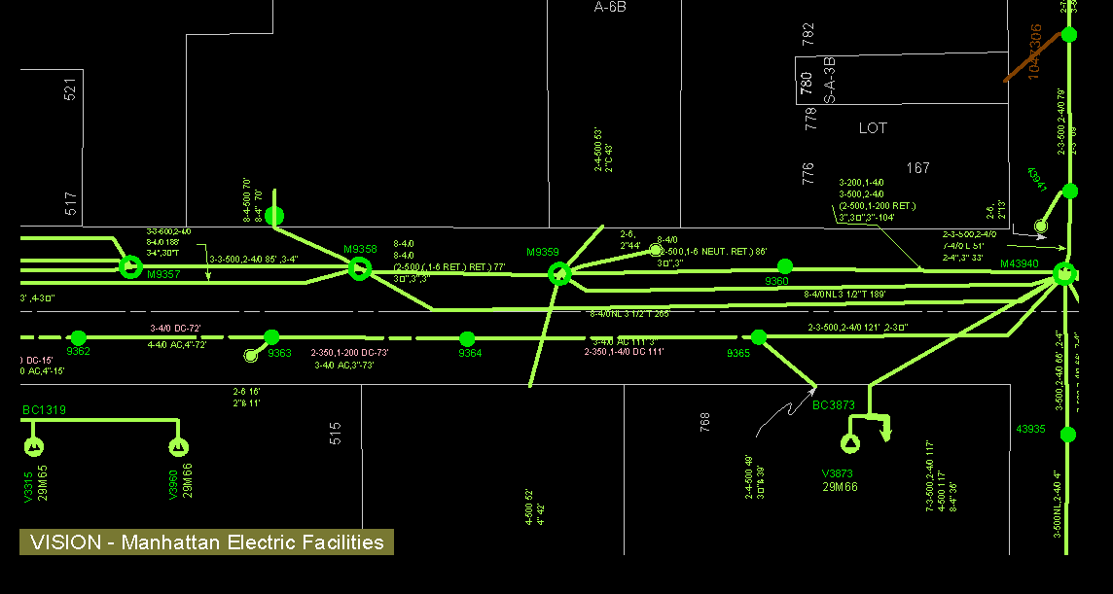
Internal Process to conduct Screen A 1
141 East 48thSt

Slide 15
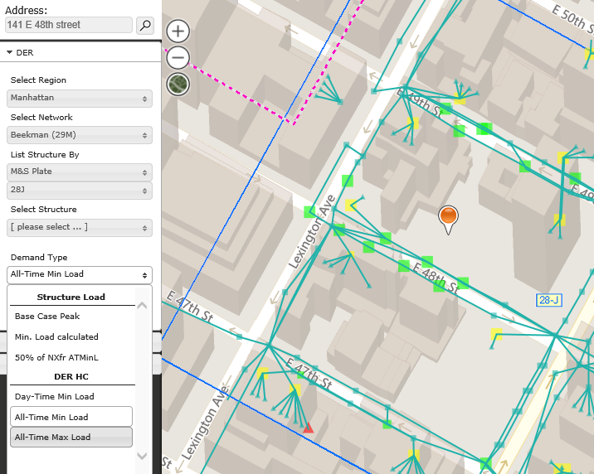
Internal Process to conduct Screen A 1
Step 2: Determine the All Time Minimum Load using our PVL Maps

Slide 16
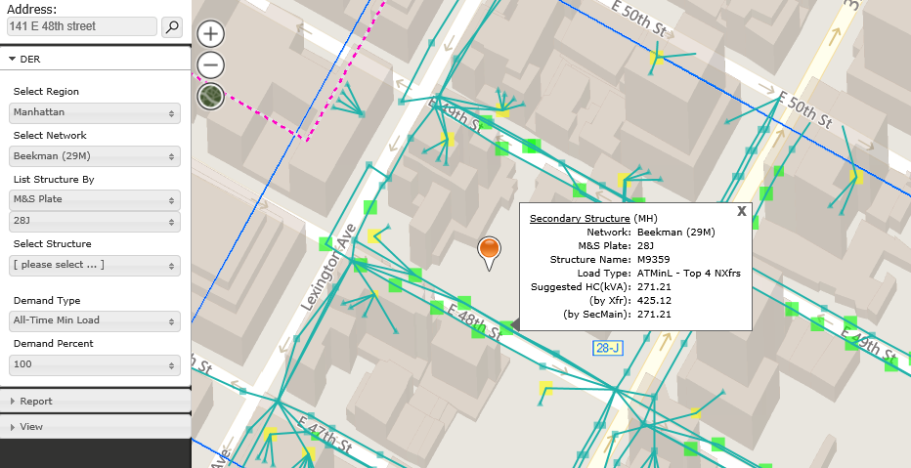
Internal Process to conduct Screen A 1
Step 3: Compare if the proposed system inverter size (kW) is less than the Suggested Hosting Capacity

Slide 17
Other considerations associated with Screen A1
As AMI rolls out across the service territory we may consider revising the methodology of this screen
Clusters of projects, as we have seen more recently would likely not be able to utilize screen A1 because they would all be exporting into the same area and thus would require further study.
The data in our PVL map tools are only as good as the frequency that they have been refreshed. We will need to coordinate this testing in accordance with the refresh rate.
Screen A1 can’t be used for projects needing new services

