Slide 1
Interconnection Policy Working Group
October 23rd, 2018
Jim Skillman
Customer Project Manager
Distributed Generation Group, Con Edison

Slide 2
Agenda
Quick Recap
Con Edison’s Distribution System Overview
NY SIR Preliminary Screening Analysis
Con Edison Issues with Preliminary Screen A
Proposed Technical “Screen A1”
Other considerations

Slide 3
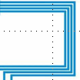
Electric Operations Overview Distribution
4kV, 13kV,
27kV, or 33kV
The Con Edison Electric Distribution System supplies power to customers primarily in one of three ways:
Low Voltage Network customers
Low Voltage Radial customers
High Tension connections
Network Systems supply 87% of Con Edison system demand
Network Grid Service
Spot/Isolated Network
Area Substation
Transformers
Feeders
480, 208, or 120 V
Radial System
Supplies 13% of System Demand
64 Network Systems
Supply 87% of System Demand

Slide 4
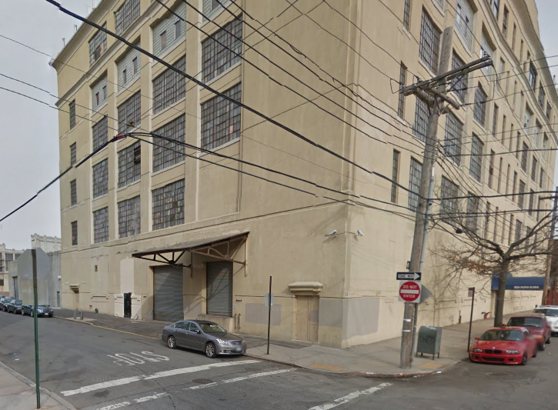
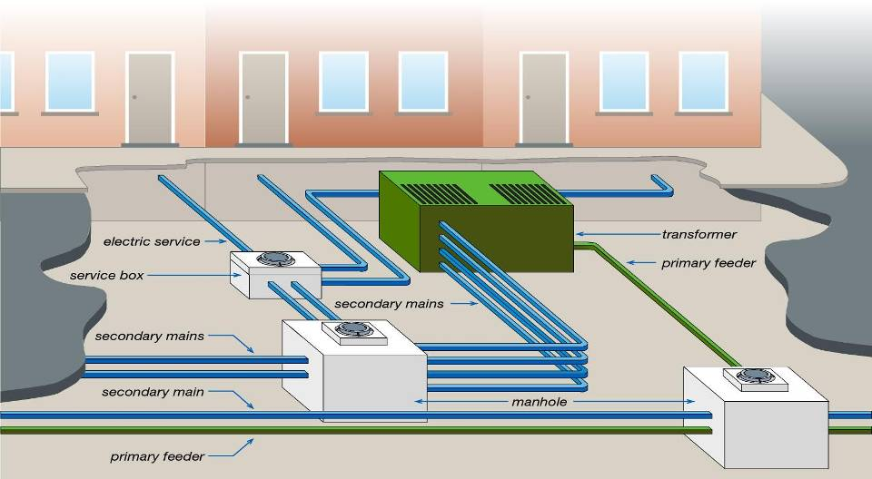
DG Implications: Network Grid Service
Network export capability depends upon multiple factors:
PV size vs service capacity
Network loading
Nearby transformer loading
Upgrades to service may require street work
Localized underground
Increased customer cost & timeline

Slide 5
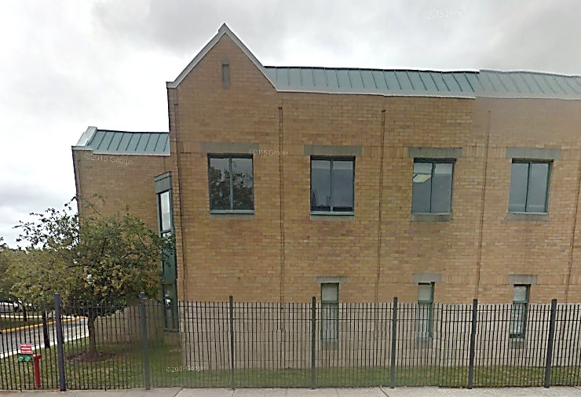
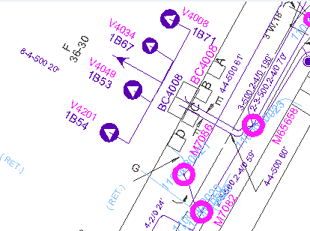
DG Implications: Isolated/Spot Network
Design used for high load density customers
Spot network has a connection to the grid, Isolated does not
Export on isolated network results in customer power loss
Cannot accept export without some form of upgrade
Solutions to enable export across network protector relays
Additional interconnection costs to accept export

Slide 6
NY SIR Preliminary Screening Analysis
The utility performs Preliminary Screening Analysis for applications above 50kW to 5MW
Appendix G details technical screens A through F
If proposed DG system passes all of the technical screens the utility provides the applicant permission to build
Any failure results in a Preliminary Screening Analysis failure meaning some further study is required

Slide 7
Preliminary Screen A
Screen A: Is the PCC on a Networked Secondary System?
Does the proposed system connect to a secondary network system?
Technical Screen A fails all applicants if the “Proposed system is connected to a secondary network system”.
Con Edison has an extensive secondary network system resulting in many applications failing Screen A
This results in most applications going directly through a CESIR study if the project would like to proceed to construction phase
Con Edison is proposing an additional review for applications that fail Screen A in an effort to avoid unnecessary CESIR’s
“Screen A1”

Slide 8
2017 Projects Breakdown
97% of DG applications in CE territory are <50kw
Of the 3%, non-export CHP accounts for 1%
75% of the export eligible projects were inverter based DG between 50kW and 150kW
Of those, 81 cases went through a CESIR study
Of those, 64 would have been eligible for Screen A1 (not overhead or new service)

Slide 9
Internal Process to conduct Screen A1
Example:
Address: 141 East 48th St, New York, NY
Structure Name: M9359
M&S Plate: 28-J
Proposed 100 kW PV System
Step 1: Find the associated structure that the PV system wants to connect to using our Internal Vision Maps

Slide 10
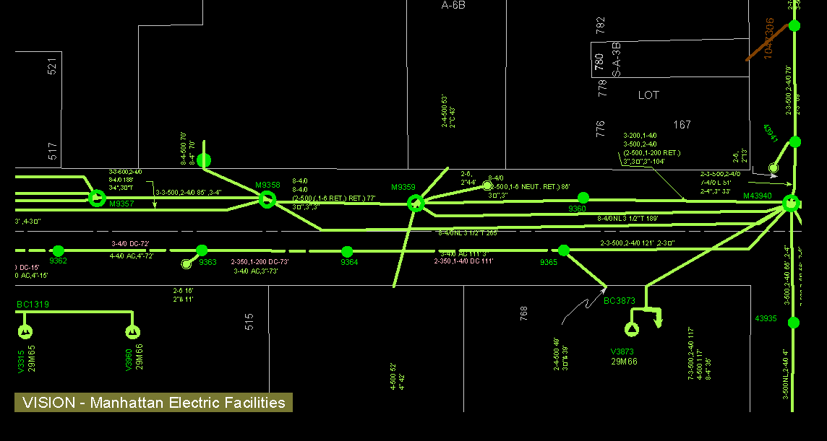
Internal Process to conduct Screen A1
141 East 48thSt

Slide 11
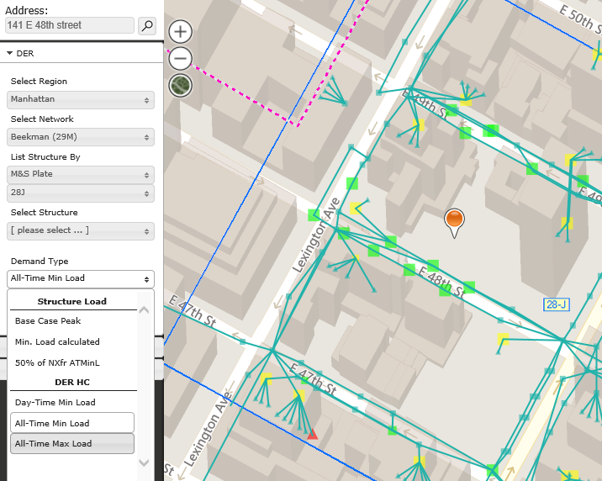
Internal Process to conduct Screen A1
Step 2: Determine the All Time Minimum Load using our PVL Maps

Slide 12
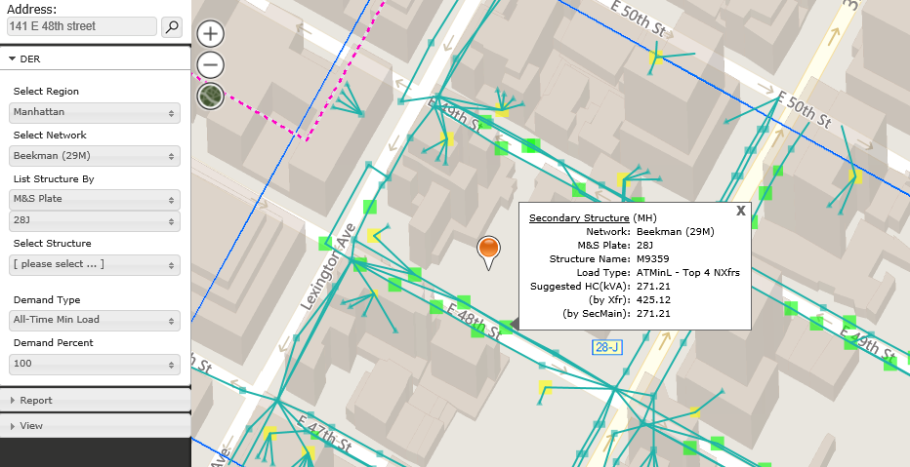
Internal Process to conduct Screen A 1
Step 3: Compare if the proposed system inverter size (kW) is less than the Suggested Hosting Capacity

Slide 13
Internal Screen A1 Examples
Example:
Address: 141 East 48th St, New York, NY
Structure Name: M9359
M&S Plate: 28-J
Proposed 100 kW PV System
Screen A1 Result: PASS
Of the 64 applications from 2017 eligible for Screen A1
60% would have failed Screen A1
40% would have passed Screen A1
CESIR study savings of > $30,000 for installers.
Of a sampling of 36 applications from 2018 that went to CESIR,
50% Failed Screen A
Of those, 28% would have passed Screen A1

Slide 14
Other considerations associated with Screen A1
Not in SIR, so cannot be incorporated as part of the Preliminary Screen process yet – intend to use after the screen is complete.
As AMI rolls out across the service territory we may consider revising the methodology of this screen.
Clusters of projects could not utilize screen A1 because aggregated export would overcome local loads requiring CESIR.
The PVL map tool data is only as good as the frequency that it is refreshed – the proper refresh rate will have to be researched.
Screen A1 can’t be used for projects needing new services as the network power flows could change significantly.

Slide 15
Next Steps for Preliminary Screen A1
Formalize criteria for when Screen A1 is to be used.
Perform Screen A1 and record results for further study.
If Screen A1 passes, proactively suggest a Preliminary Screen Review Meeting to the Applicant.
If a CESIR can be avoided, provide permission to build to the Applicant and record results for further study.
The DG Group to review the results and coordinate with Distribution Engineering to assess next steps.

Slide 16
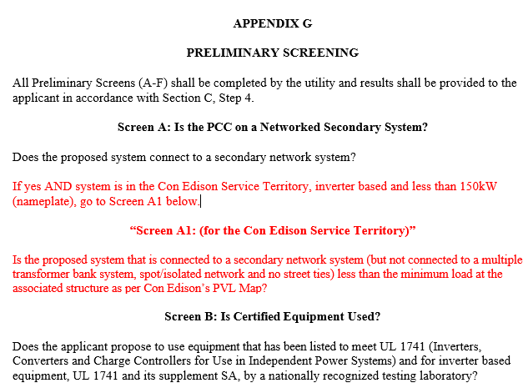
Next Steps for Preliminary Screen A1?

Slide 17
Questions?
Thank you!
Jim Skillman
Customer Project Manager
Distributed Generation Group, Con Edison
skillmanj@coned.com

