Slide 1
SIR Update Needs: Milestone Transparency
NYSEIA
IPWG meeting
April 2019

Slide 2
MILESTONE TRANSPARENCY: BACKGROUND
Problem: Current SIR milestones (as reported in SIR inventory) and enforcement requirements are insufficient
Lack of knowledge on the part of subsequent interconnecting customers disadvantages them beyond what would be a fair competitive advantage for the first mover
Lack of certainty regarding the timing of utility and developer steps along the path to project completion add to this problem, which increases soft costs and discourages future development
Goal: Provide more transparency into the status of projects in the queue regarding whether project has moved into final design/upgrade design process

Slide 3
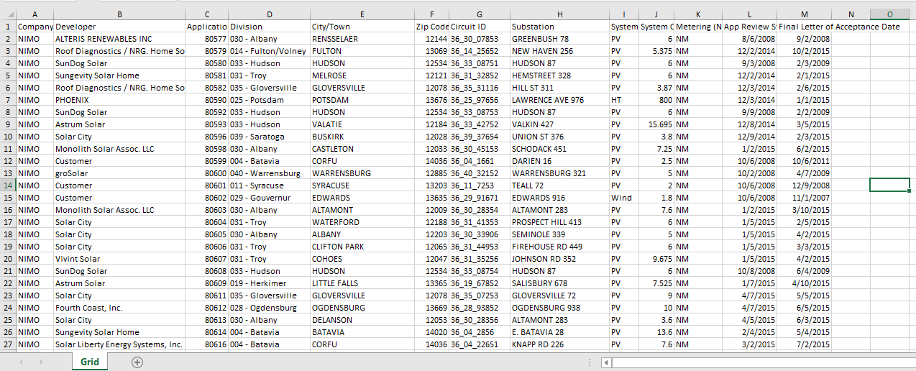
CURRENT SIR QUEUE DATASET - SNAPSHOT
App review start date
Final Letter of Acceptance Date

Slide 4
PROPOSED QUEUE MILESTONE DATA FIELDS*
100% Payment Date
25% Payment Date
* NYSEIA has surveyed developers regarding potential confidentiality issues relating to these additional data fields and has not received notice of concern from any firms.

