Slide 1
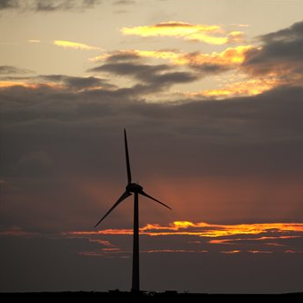
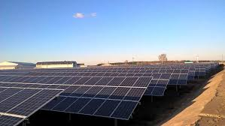
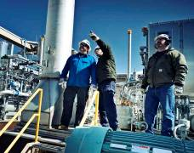
Distributed Generation 3VO Interconnection Demonstration Project
Reforming the Energy Vision (REV)

Slide 2
3VO Demonstration Project Scope
National Grid is excited to present to you a great opportunity to site your next DG facility in a “Demonstration Project” area intended to interconnect projects in a more timely and cost effective manner than in other areas across our system. This opportunity is the result of an approved NYS Department of Public Service Staff REV “DG Demonstration Project” whereby National Grid is testing alternative solutions for increasing the pace and scale of interconnecting distributed generation systems above 50 kW.
The “Demonstration Areas” include those areas serviced by our Peterboro (Canastota, NY) and East Golah substations (Rush, NY). These substations are presently being upgraded with 3V0 ground fault protection. These upgrades will help make the system “DG ready”. The transformer bank capacity that has been set aside for DG is 20 MVA at each location and plenty of capacity presently remains.
To recoup the investment costs, National Grid will charge a pro-rated fee to all applicants with DG systems above 50 kW who connect to the upgraded substation transformer banks in the Demonstration Areas.

Slide 3
3VO Demonstration Project Advantages
REDUCED CONSTRUCTION LEAD TIME
Both stations will be “DG ready” December 2017 vs the typical 3V0 installation time of over 12 months.
COST SAVINGS
Estimated 3V0 cost of $32/kW at East Golah substation and $56/kW at Peterboro substation represent a significant cost savings versus the current cost recovery mechanism per the NYS SIR.

Slide 4
Substation Maps
The following slides contain maps for each substation. The first map will illustrate the individual distribution feeders served by the designated substation.
The additional maps for each substation will highlight in blue the feeder areas that should accommodate a 2MW project with minimal distribution system upgrades.
The Peterboro Substation serves approximately 8,000 customers using eight distribution feeders.
The East Golah Substation serves approximately 7,500 customers using six distribution feeders.

Slide 5
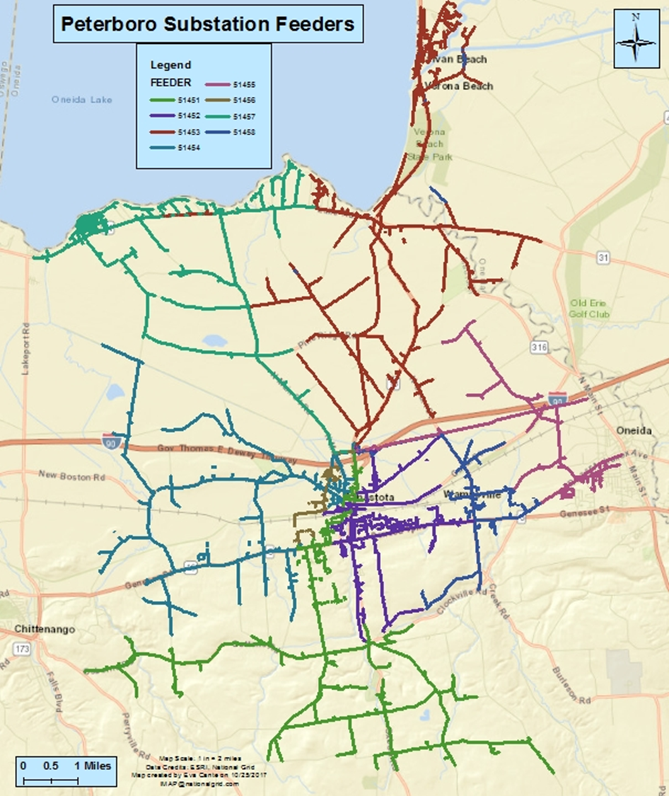
Peterboro Substation Canastota, NY 13032

Slide 6
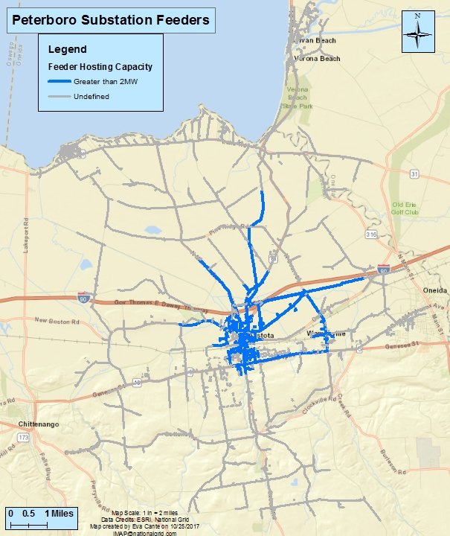
Peterboro Substation Canastota, NY 13032

Slide 7
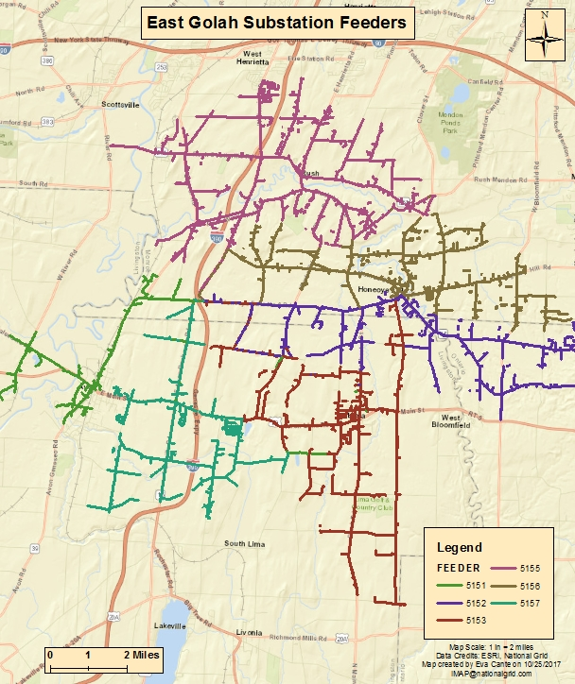
East Golah Substation Rush, NY 14543

Slide 8
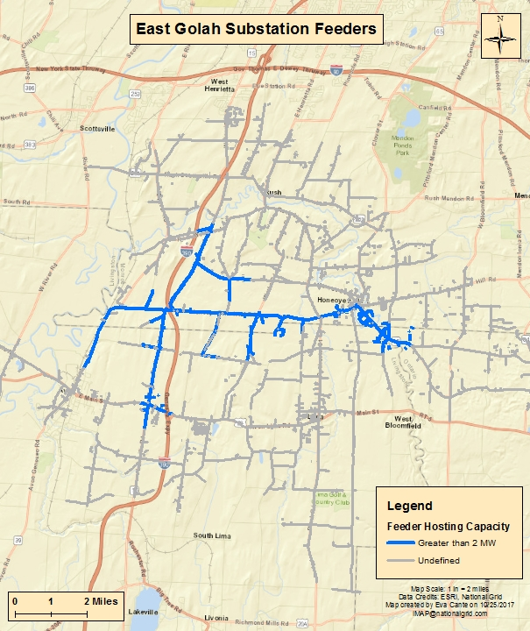
East Golah Substation Rush, NY 14543

Slide 9
Cost Recovery Mechanism
To recover the common-system upgrade costs, National Grid will charge a one-time pro-rated fee to each applicant with DG systems above 50kW that interconnects in the Demonstration Areas.
The fee will be based on the estimated common-system upgrade costs (subject to true up once actual costs are known) in each of the respective Demonstration Areas divided by a factor that represents the substation transformer bank’s capacity.
Distributed Generation applicants under this program will remain responsible for their respective site-specific and any other distribution line upgrade costs that are outside of the common system upgrade charge under the Demonstration Project.

Slide 10
Cost Recovery Mechanism ; ILLUSTRATIVE SAMPLE

Slide 11
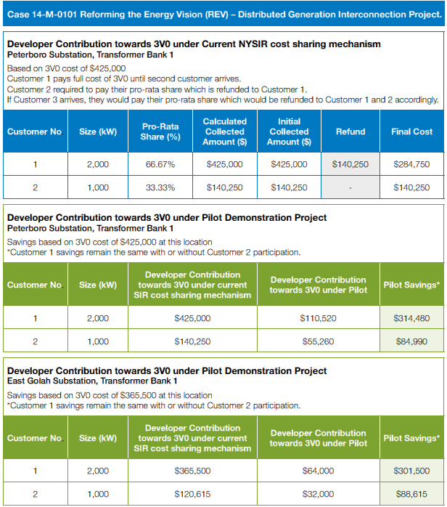
Cost Recovery Mechanism : PILOT SCENARIO ILLUSTRATIVE SAMPLE

Slide 12
How would Key Stakeholders get started? Application submittal and review
The Application requires detailed documents that are utilized in the completion of a Preliminary Screening Analysis that determines if a project can proceed to construction or requires further study.
Application Fee is $750.
Utility has 10 Business Days to review Application.
If application is deemed deficient, applicant is notified in writing and has 30 Business Days to correct identified deficiencies.
For applications that are submitted correctly and packaged so that all the required information is provided at the same time, movement from the Application Received to Preliminary Screening Analysis takes place within the 10 Business Days.
Distributed Generation applicants under this program will remain responsible for their respective site-specific and any other distribution line upgrade costs that are outside of the common system upgrade charge under the Demonstration Project.

Slide 13
Reference Links
NY-National Grid Distributed Generation Customer Portal Website
NY PSC Standardized Interconnection Requirements (NYSIR)
P.S.C. No. 220 Electricity Tariff
Electric System Bulletin 750-Specifications for Electrical Installation
Electric System Bulletins, including 756-Requirements for Parallel Generation

Slide 14
Thank You
National Grid Customer Energy Integration
Timothy S. Dzimian, CEM, BOC Energy Integration Consultant Customer Energy Integration – NY National Grid 144 Kensington Ave. Buffalo, NY 14214-2726 Office Phone: (716) 831-7747 | Michael F. Pilawa Manager Customer Energy Integration – NY National Grid 221 Old Campion Road New Hartford, New York 13413 Office Phone: (315) 798-5367 Cell Phone: (315) 723-5627 | Thomas V. Higgins CEM Energy Integration Consultant Customer Energy Integration – NY National Grid 221 Old Campion Road New Hartford, New York 13413 Office Phone: (315) 798-5158 Cell Phone: (315) 723-2199
Ronald Lelonek Energy Integration Consultant Customer Energy Integration – NY National Grid 144 Kensington Ave. Buffalo , NY 14214 Office Phone: (716) 831-7751 | Francis Kane Energy Integration Consultant Customer Energy Integration – NY National Grid 300 Erie Boulevard., Syracuse NY 13202 Office Phone: (315) 460-1006 Cell Phone: (315) 418-7306 | Steven Maybloom Energy Integration Consultant Customer Energy Integration – NY National Grid 1125 Broadway Albany, N.Y. 12204 Office Phone: (518) 433-3311
Rocco A. Carbone Lead Analyst Customer Energy Integration – NY National Grid 144 Kensington Ave Buffalo, N.Y. 14214 Office Phone: (716) 831-7662 Cell Phone: (716) 472-6333 | John Napolitano Energy Integration Consultant Customer Energy Integration – NY National Grid 300 Erie Blvd West B-1 Syracuse, NY 13202 Office Phone: (315) 460-1629 Cell Phone: (315) 289-7089 | Eugene R. Hickok Energy Integration Consultant Customer Energy Integration – NY National Grid 1 Apollo Drive, Glens Falls, NY 12801 Office Phone: (518) 761-5905 Cell Phone: (518)491-1348

