Slide 1
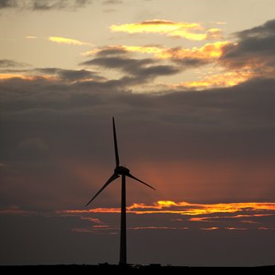
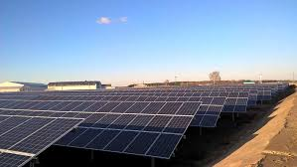
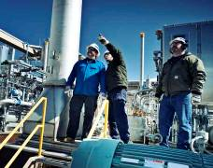
Adding Energy Storage to Pending Solar Photovoltaic Generation Applications

Slide 2
General Requirements
The Intern Guidelines are applicable to completed PV applications in the interconnection queue above 50 kW (Existing Projects), not going through the expedited SIR application process as of December 21, 2018.
Applicants seeking to follow these guidelines are required to submit applications to add storage between December 21, 2018 and COB February 1, 2019.
These guidelines are applicable to completed PV applications that have finished the CESIR study, that are currently undergoing CESIR study, or that have not yet started a CESIR study.
PV applications proposing to add storage under these guidelines will not lose queue position; however, the utilities will study the storage request as a new application for purposes of determining the project’s responsibility for system modifications.
These procedures do not apply to projects 50 kW and below, going through the expedited SIR application process. Those projects shall be required to re-apply if requesting to add ESS to an existing PV project.
If proposing to add ESS to an existing PV project in the utility’s interconnection queue, the PV project shall continue to proceed as normal and all associated SIR process and payment deadlines shall stay in effect.
All existing SIR rules and procedures shall be adhered to.

Slide 3
General Requirements
Tier 1 Projects:
ESS charged from the PV only and DC coupled,
No proposed changes to the system’s operating characteristics, maximum export, or anything else different from the original PV project and associated study / impact analysis characteristics, except:
The applicant may request that the utility evaluate an expansion of the system’s maximum export window used in the original CESIR to a window ending at 7 pm to better align with VDER rules.
Inverter type configurations may have changed due to the addition of ESS.
No transformer or grounding changes proposed.
Tier 2 Projects:
Same as Tier 1 with the following exception:
Proposal includes changes to transformer or grounding configurations.
Tier 3 Projects:
ESS charged from the PV and/or utility system, or
AC coupled, or
Changes not identified within Tier I or Tier 2 projects.
The impact of the proposed system cannot be determined and a CESIR will be required. Utility will provide a detail identifying the reasoning in which further study would be needed.

Slide 4
Pending Applications in Queue

