Slide 1
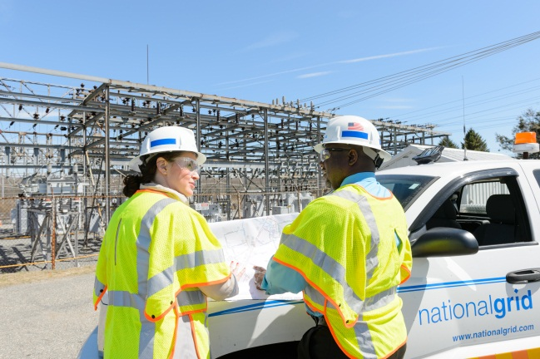
Post-construction Submittals to Utility by Applicant

Slide 2
Suggested Changes to NYSIR
STEP 11: Final Acceptance and Utility Cost Reconciliation
If the utility witnessed the verification testing, then, within ten (10) Business Days of the completion of such testing, the utility will issue to the applicant either a formal letter of acceptance for interconnection or a detailed explanation of the deficiencies in the system. If the utility did not witness the verification testing, then, within ten (10) Business Days of receiving the written test notification from Step 9, the utility will either issue to the applicant a formal letter of acceptance for interconnection, or will request that the applicant and utility set a date and time to witness operation of the DG system. This witnessed verification testing must be completed within twenty (20) Business Days after being requested. Within ten (10) Business Days of the completion of any such witnessed testing, the utility will issue to the applicant either a formal letter of acceptance for interconnection or a detailed explanation of the deficiencies in the DG system. Within sixty (60) Business Days after issuance of the utilities formal letter of acceptance or submittal of final as-built drawings to the utility, whichever occurs last, the utility shall prepare and submit to the applicant a final reconciliation statement of its actual costs minus the application fee less any advance payments made by the applicant. Within twenty (20) Business Days after delivery of the final reconciliation statement, the applicant will receive either a bill for any balance due or a reimbursement for overpayment from the utility as determined by the utility’s reconciliation. The applicant may contest the reconciliation with the utility. If the utility’s final reconciliation invoice states a balance due from the applicant, unless it is challenged by a formal complaint interposed by the applicant, it shall be paid to the utility within thirty (30) business days or the utility reserves the right to lock the generating system offline. If the utility’s final reconciliation invoice states a reimbursement for overpayment to be paid by the utility, unless the reimbursement amount is challenged by a formal complaint interposed by the applicant, it shall be paid to the applicant within thirty (30) business days. If the applicant is not satisfied, a formal complaint may be filed with the Secretary to the Commission.

